Slide 1

SAFE BANKING

Slide 2
Hello!
Prepared by:
TRISHA CHAKRABORTY
Summer Intern 2018
IIT ROPAR

Slide 3
The Abstract
As the name specifies “SAFE BANKING” is a software developed for carrying out banking transaction with the main concern of enhancing security into the process of login and logout. Here we have implemented user picture verification along with password validation. One user needs to provide userid and a random code in the initial step. If the userid is existing, then it will redirect to the second page where the user need to enter password and have to select one security picture which he selected during the registration procedure. On successful password and picture validation, the user can access his/her bank account and can avail the banking facilities.

Slide 4
Software Required
MySQL 5.7
Used for creating the database and storage of student and hostel data.
This needs a connector file for running any project.
This connector file is already included into the project which can be found inside eclipse->Safe Banking->WebContent->WebInf->lib->connector
JDK
Download JDK and install it into the machine. Set the environment variable and path.
IDE: Eclipse Oxygen March(2018)
Used for integration of front end to the persistent layer with mySQL 5.7 as back end.
Tomcat(Version 9)
Download tomcat and then read tomcat installation word document attached.

Slide 5
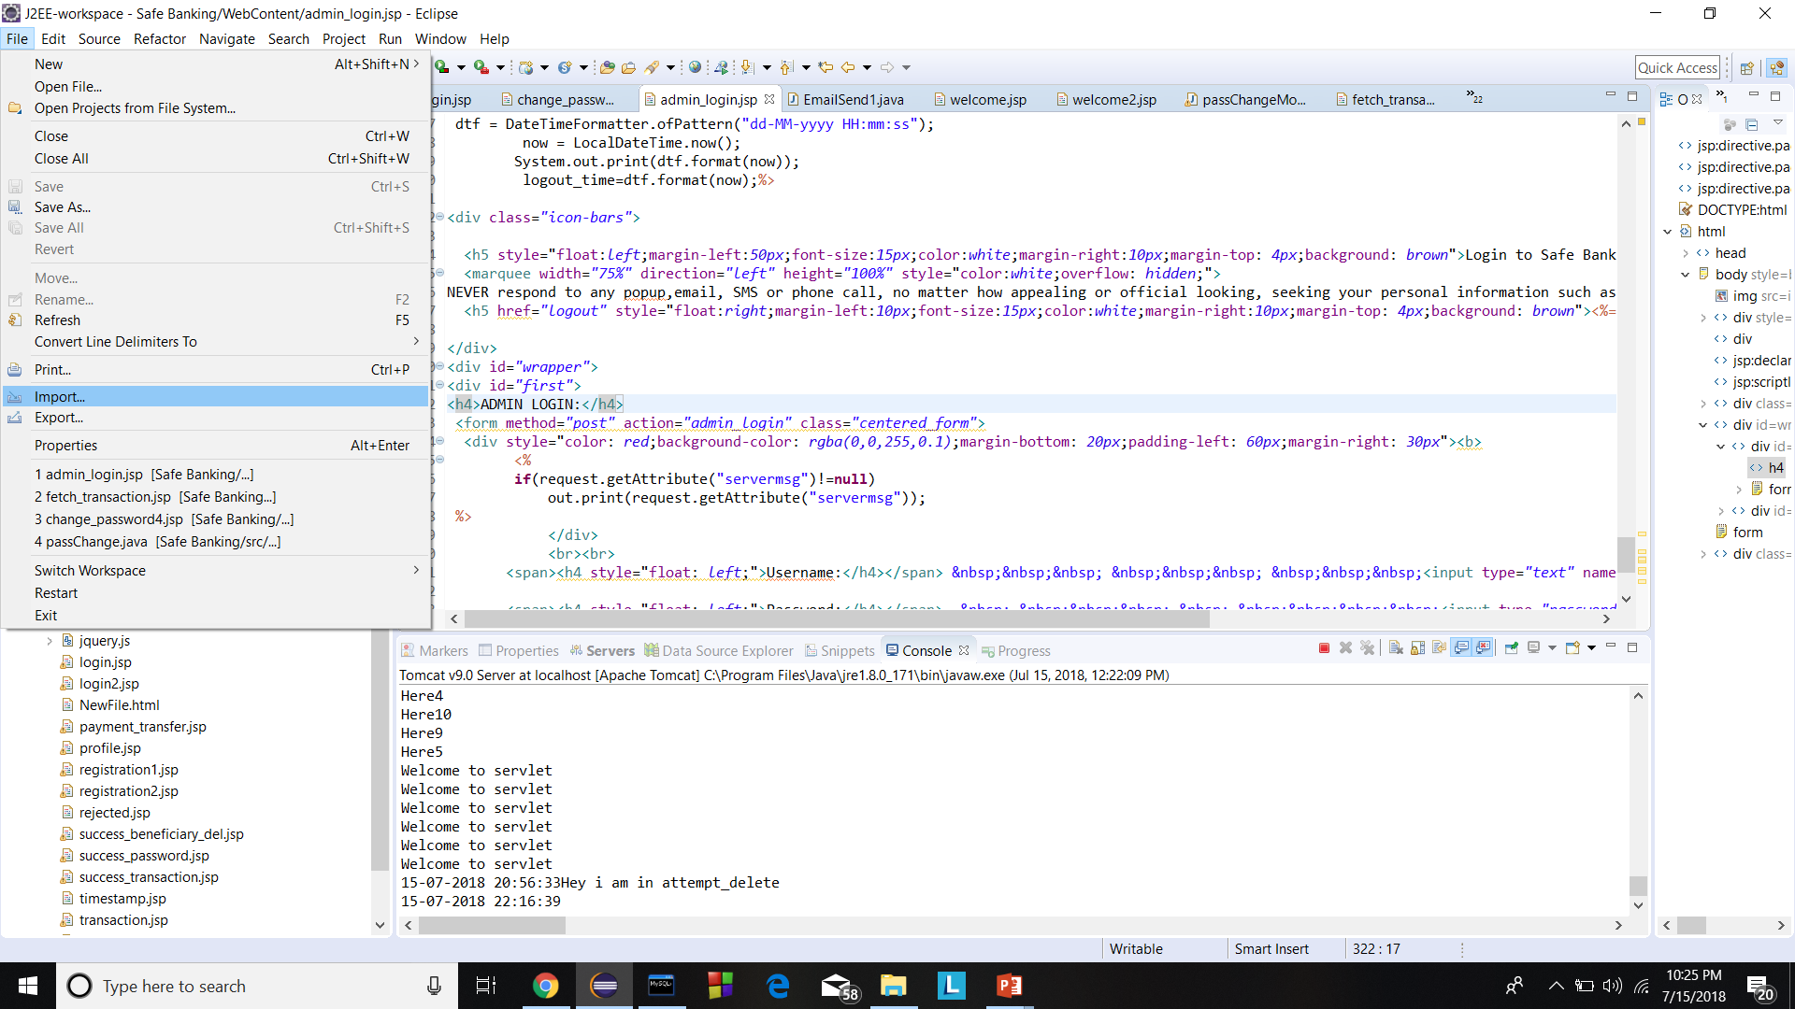
Project Import
After all the software have been successfully installed, we need to import the war file which can be done using the following steps:
File→Import→Type filter text→Type “.war file”→Browse the war file→Finish

Slide 6
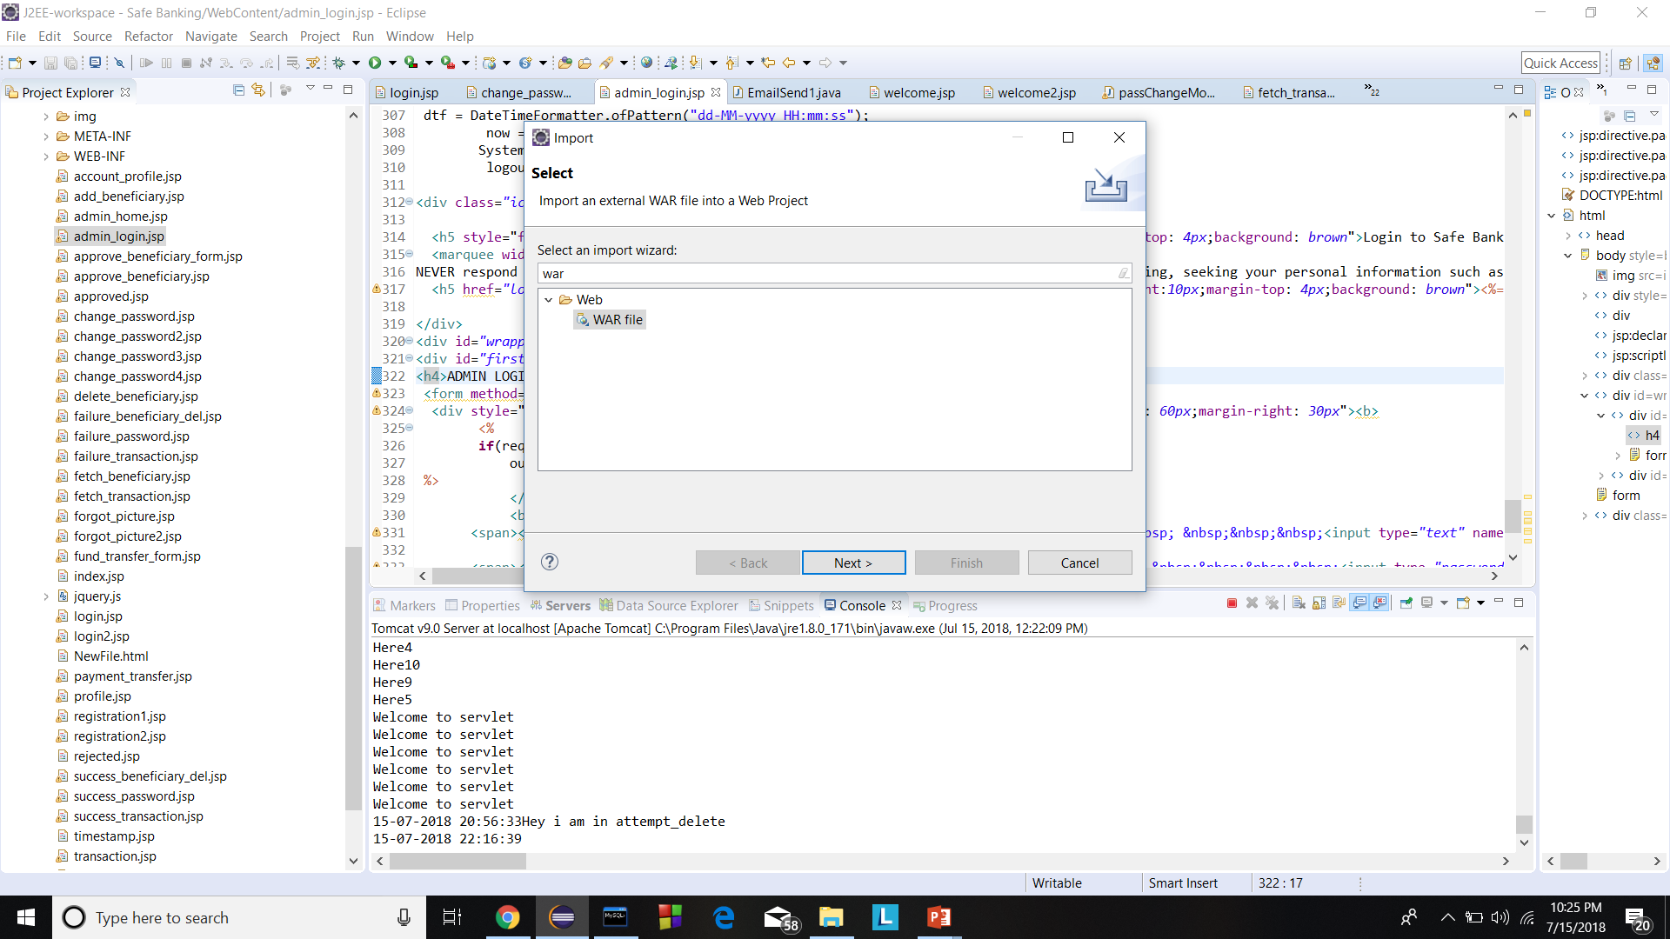

Slide 7
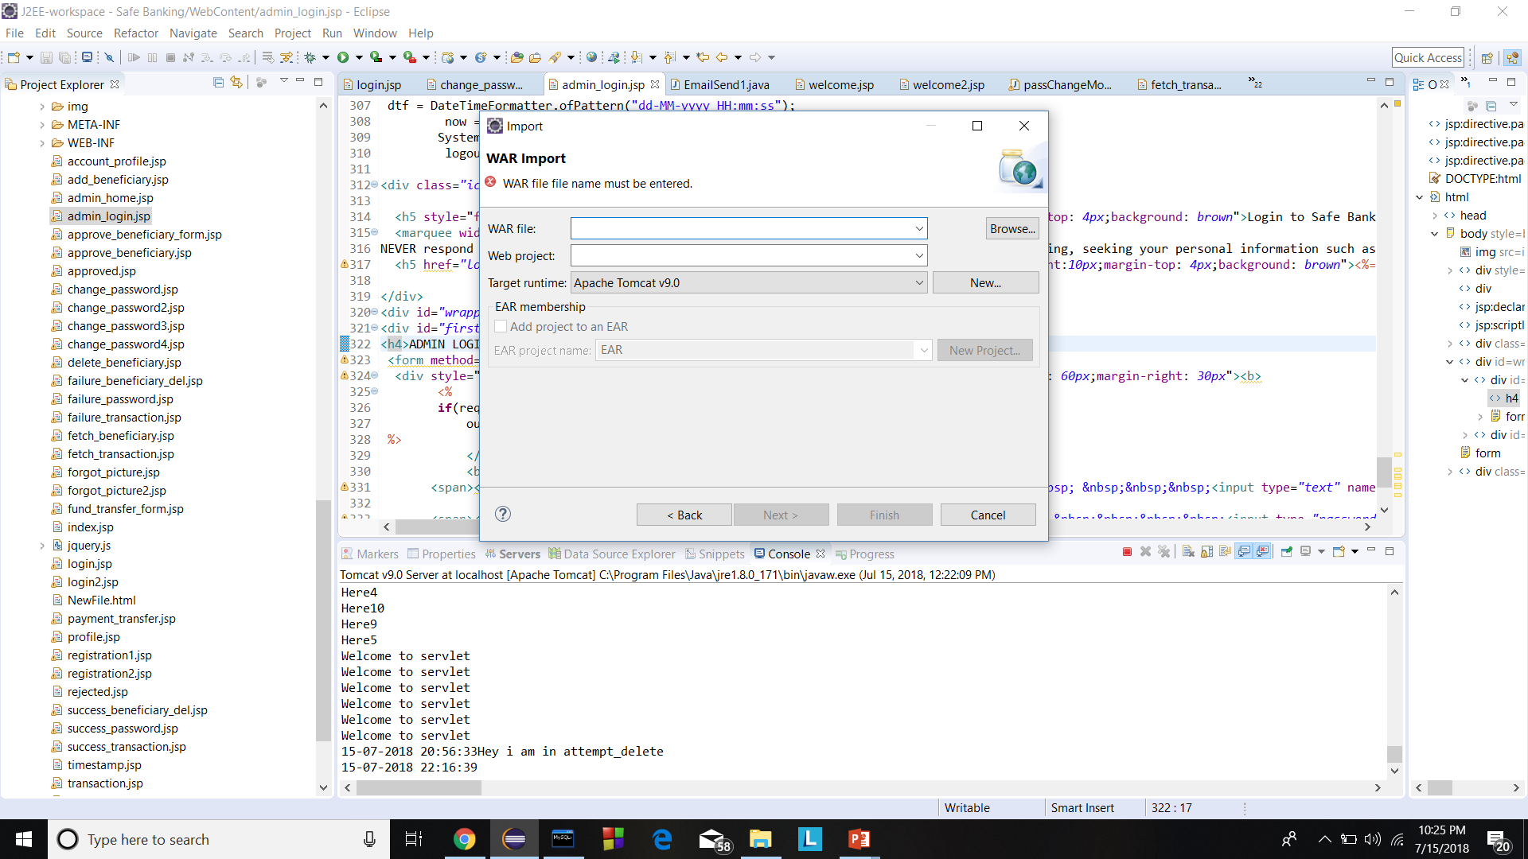

Slide 8
Project Structure
This project is developed using MVC (Model View Controller) using J2EE (Java Enterprise Edition) Framework.
The project file is so divided into 5 portions:

Slide 9
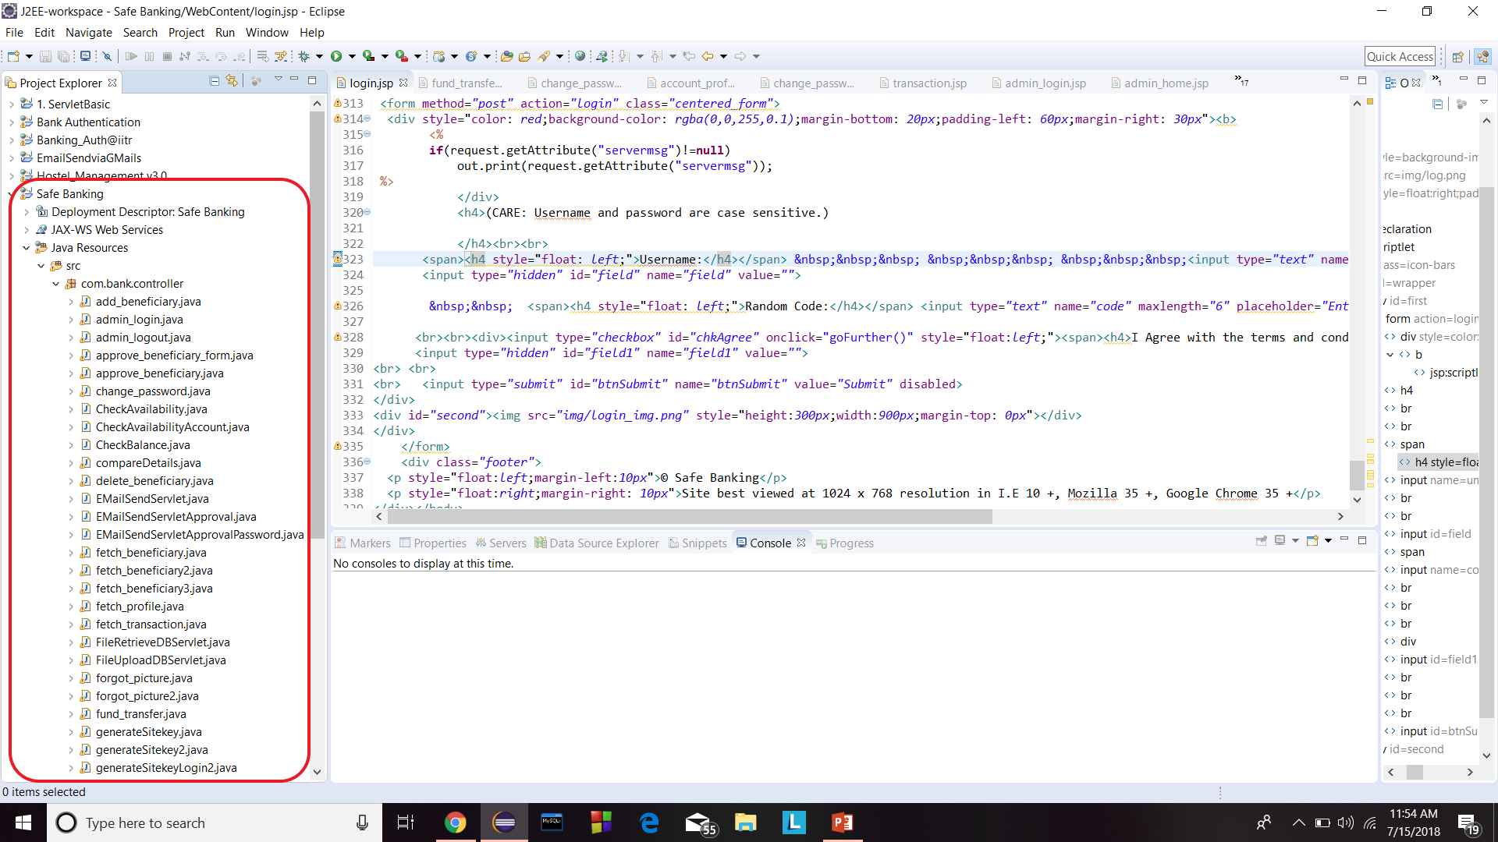
Controller: This package contains the servlet files. This files can be found under Safe Banking->Java Resources->src->com..controller.

Slide 10
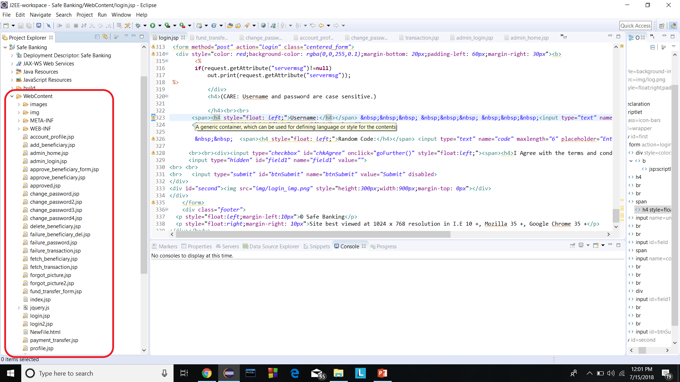
View: This package contains the view files like jsp, html. This files are found under Safe Banking->WebContent

Slide 11
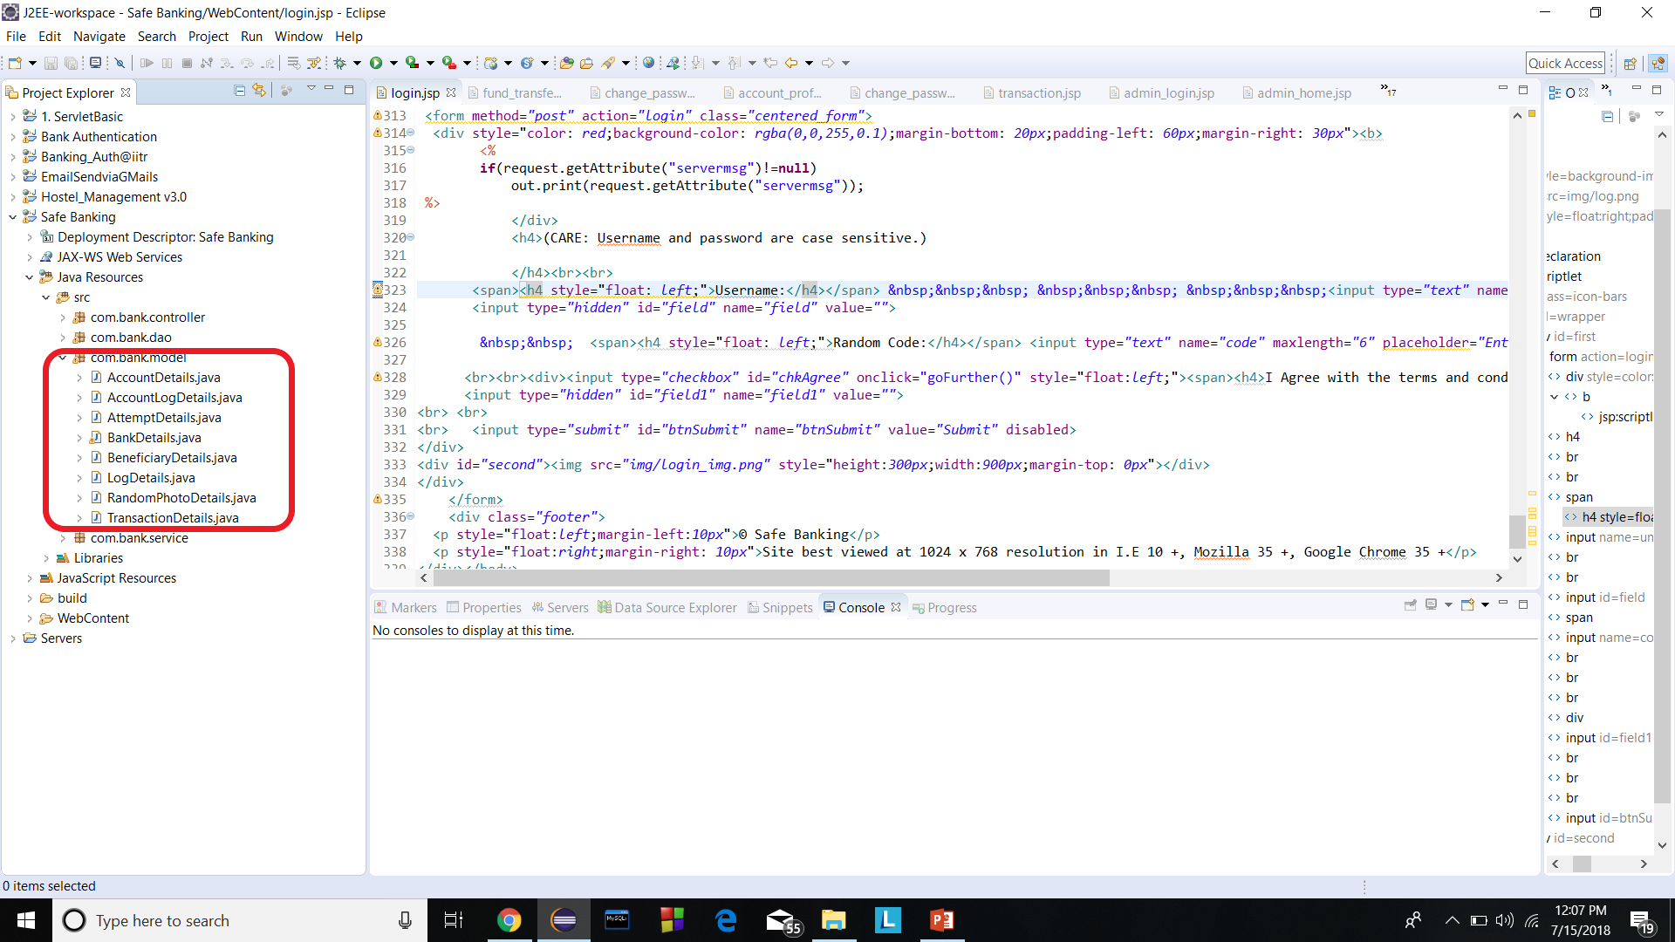
Model: This package contains the .java files which carries data from the servlet to DAO (Database Layer). Can be found under, Safe Banking-> Java Resources->src->com.bank.model

Slide 12
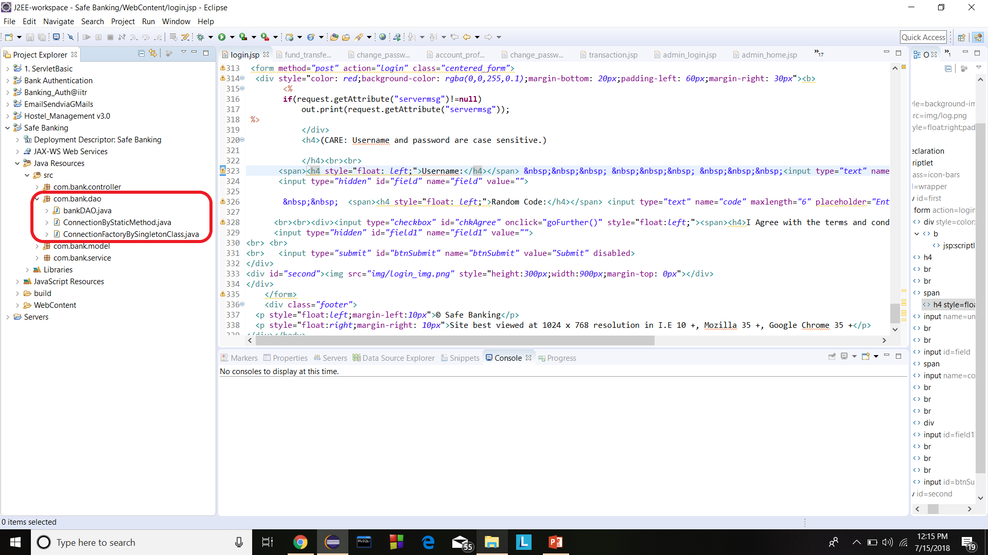
DAO: This package contains file which are only specialized for database related operation like insert, delete, alter and other DDL operations to be performed. Can be found under, Safe Banking-> Java Resources->src->com.bank.dao
bankDAO.java: This file contains all the database related operations.
ConnectionByStaticMethod.java: This file is responsible for establishing connection between the project file and the database. The object of this class is extended everywhere whenever there is a need of accessing database.

Slide 13
Service: This package contains file that provides special functionality like emails.
EmailSend1.java: This file facilates email service during login. Generates login alert.
EmailSend2.java: This file facilates email service during approve beneficiary. Generates one time password and sends it to user’s email.
To change the email id through which the emails would be send go to
line 21,22,23 and change them accordingly. Set the gmail account to low security(https://support.google.com/accounts/answer/6010255?hl=en)

Slide 14
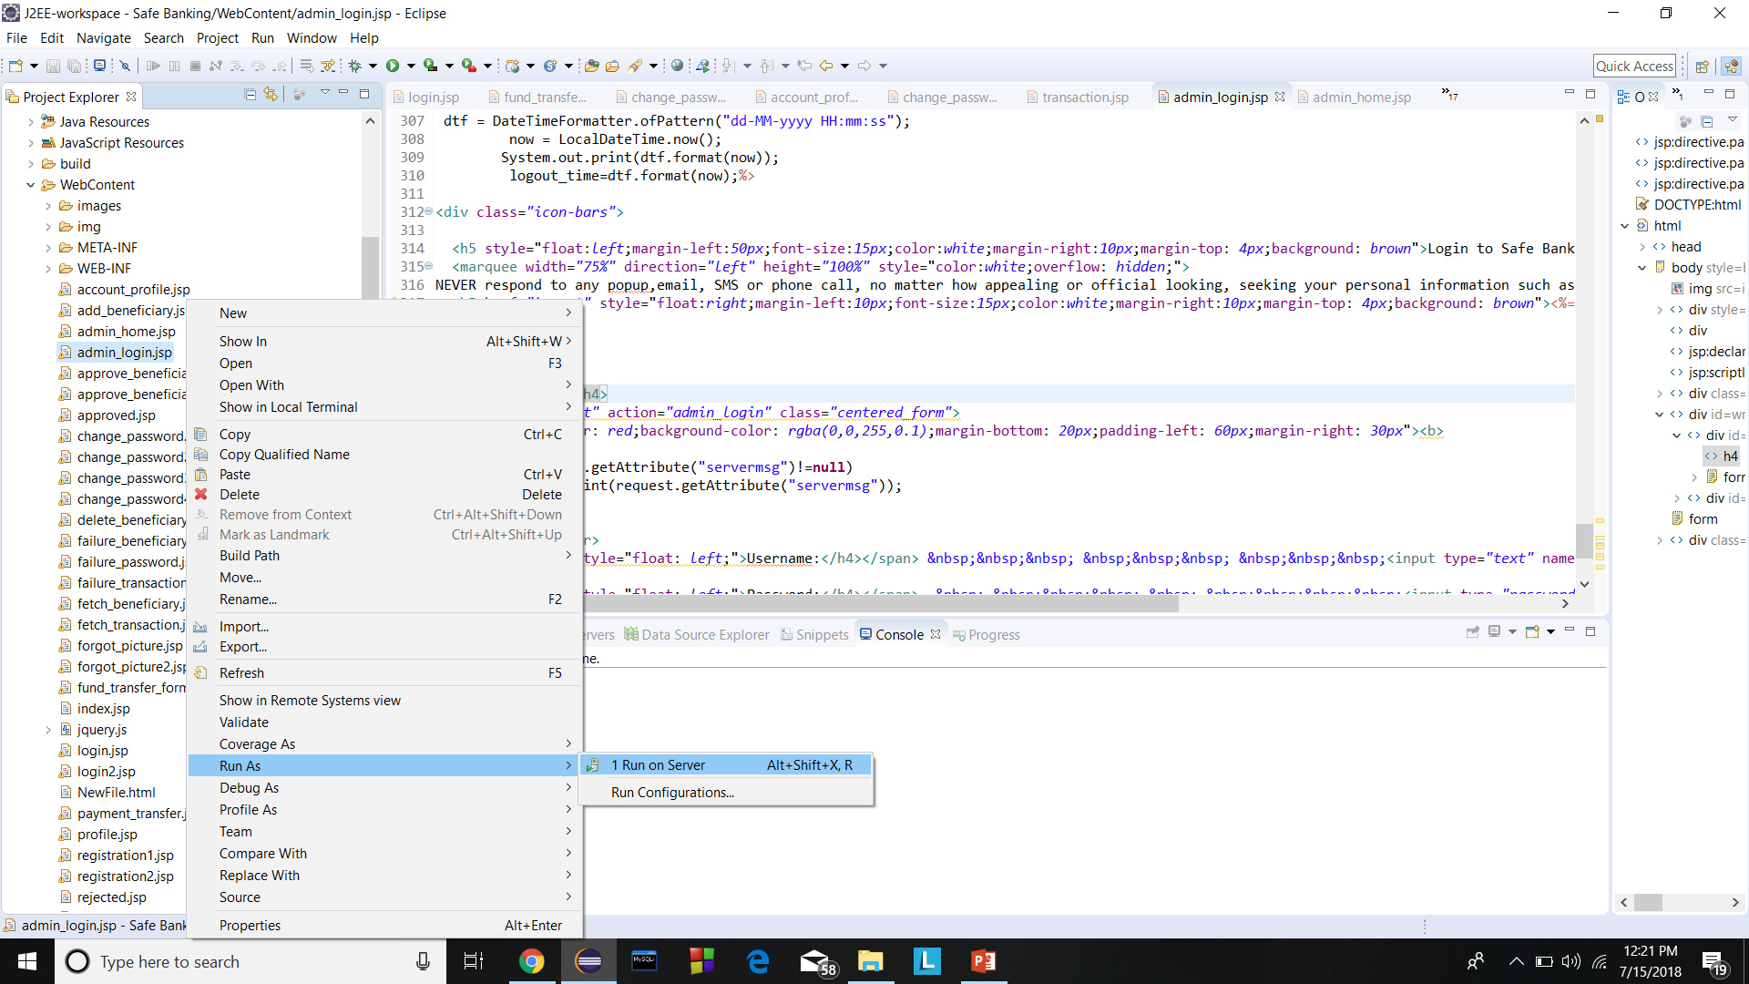
How to run the project: (Admin Login)
Open Eclipse
Go to Safe Banking->WebContent->admin_login.jsp->left click on admin_login.jsp->run as->run on server->Finish

Slide 15
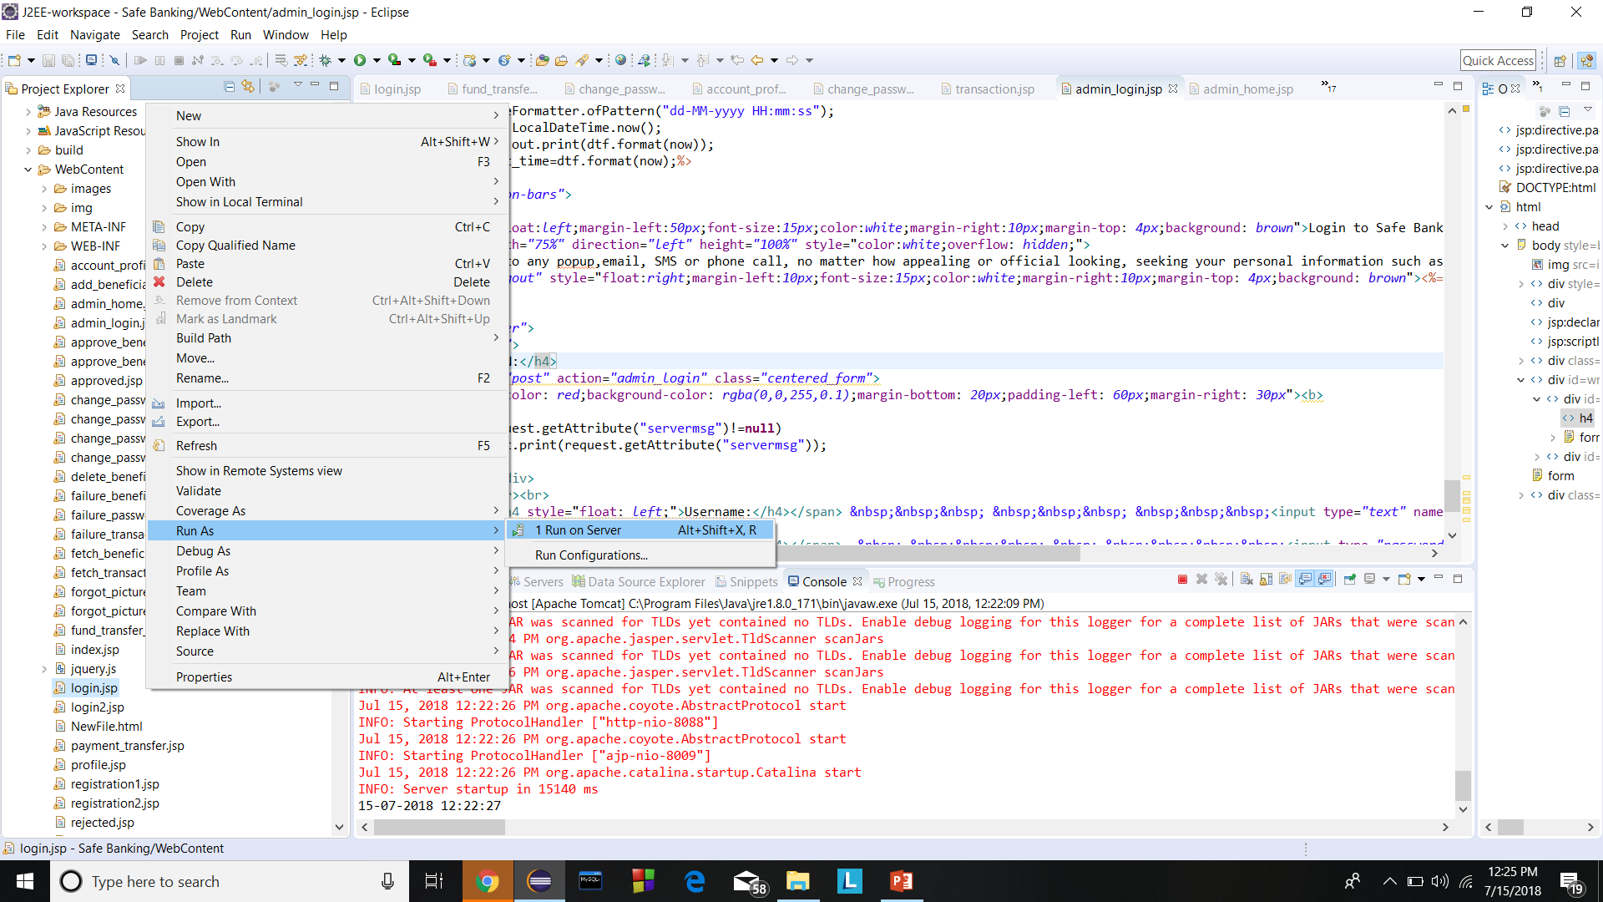
How to run the project: (Customer Login)
Open Eclipse
Go to Safe Banking->WebContent->login.jsp->left click on admin_login.jsp->run as->run on server->Finish

Slide 16
Customer Login Slides

Slide 17
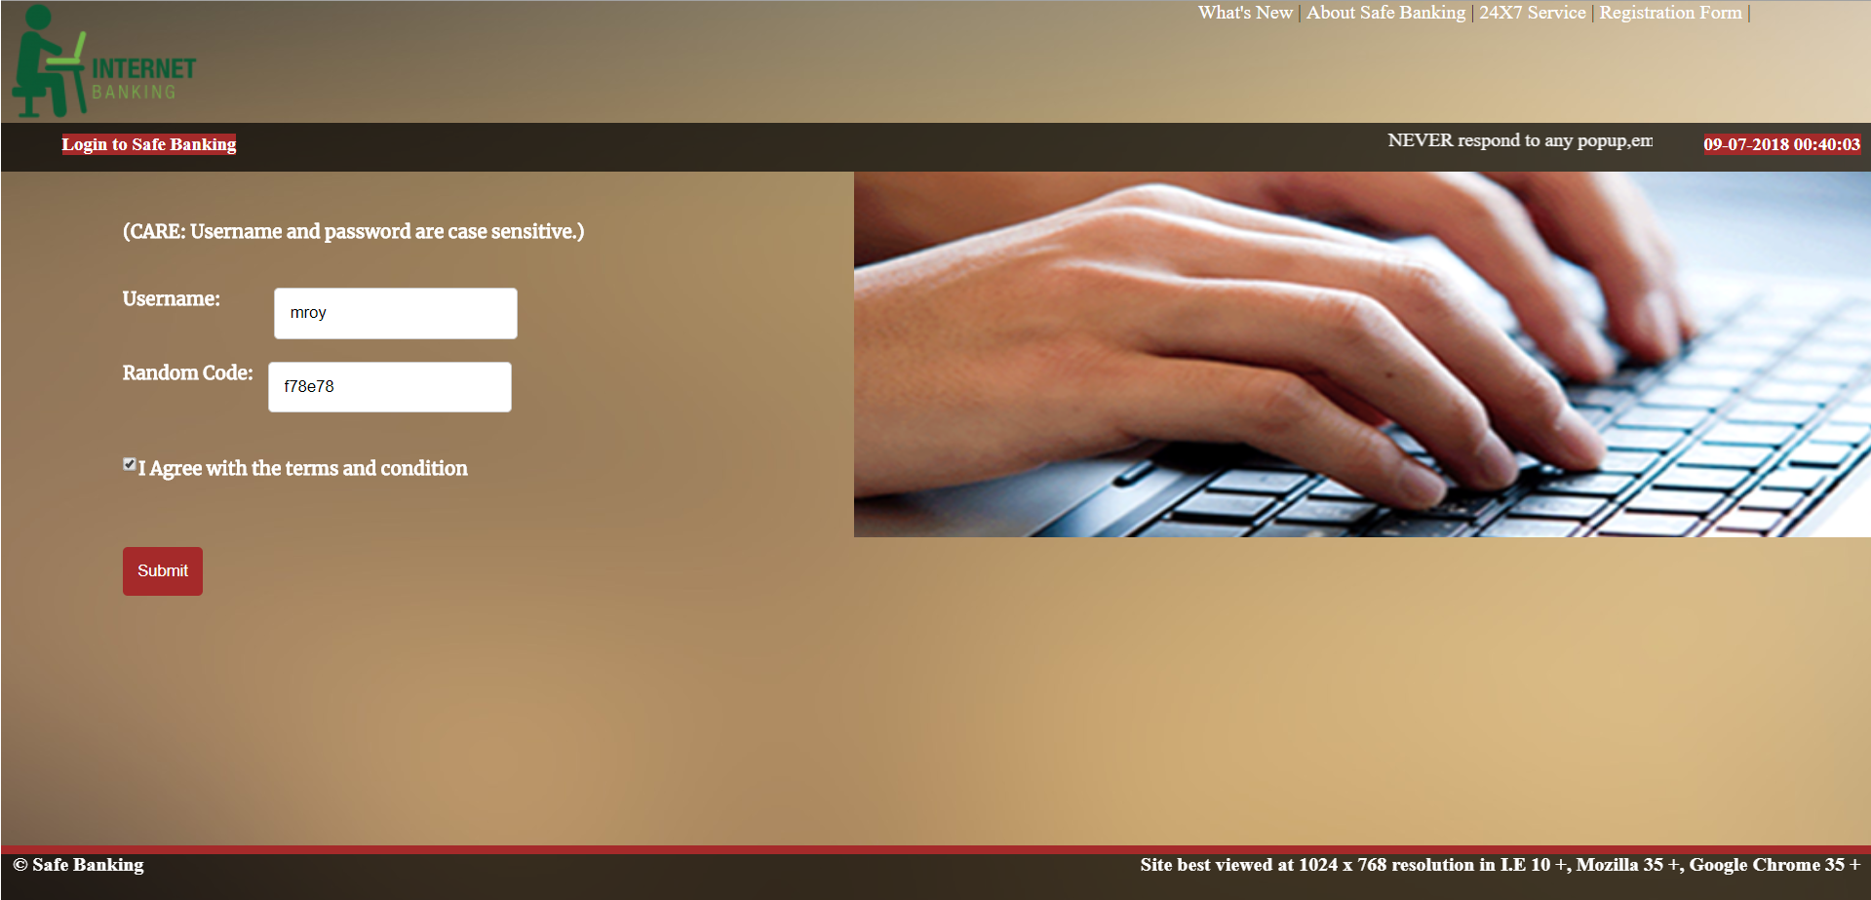
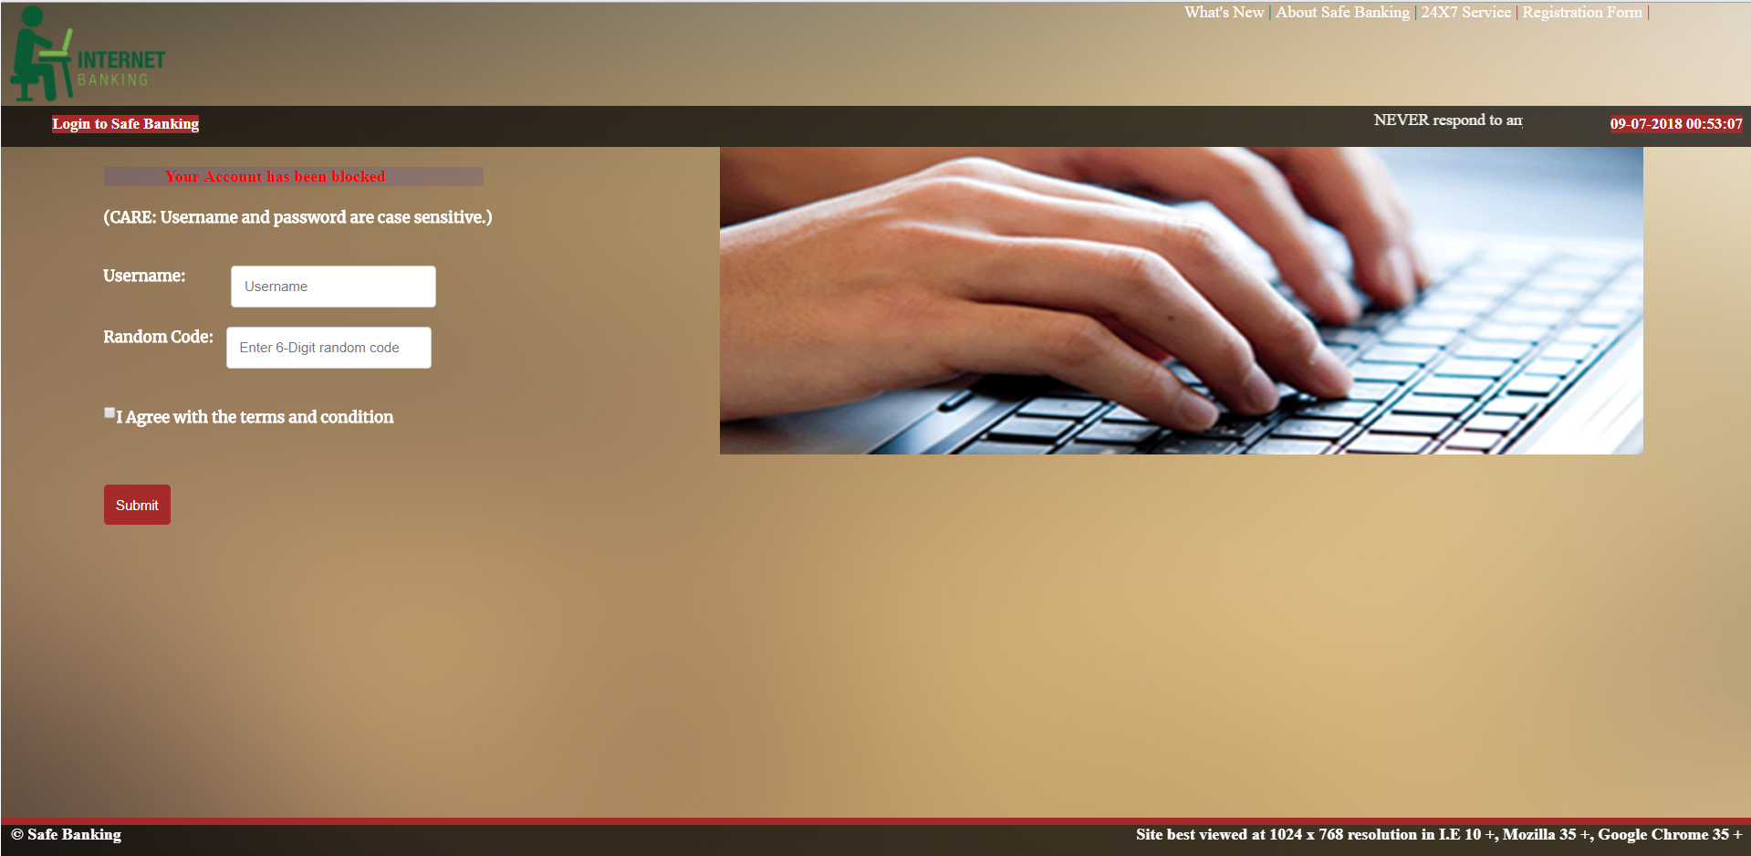
Login
File name: login.jsp
This page is responsible for login in an account holder who is already registered with the bank.
The username and one time code can be typed into the box and by checking in the checkbox, account holder will be redirected to the next page.
For 5 unsuccessful login attempt, the account gets locked which could be unlocked from Admin profile.

Slide 18

Customer Database
Database table name: bank
To view the bank table:
Open mySQL command line.
Provide password: trisha97
Change directory→ use iitr;
Type Query: select * from bank;
Select any userid and password for opening the account
Example: userid→ trisha97
password→trisha97
image→

Slide 19
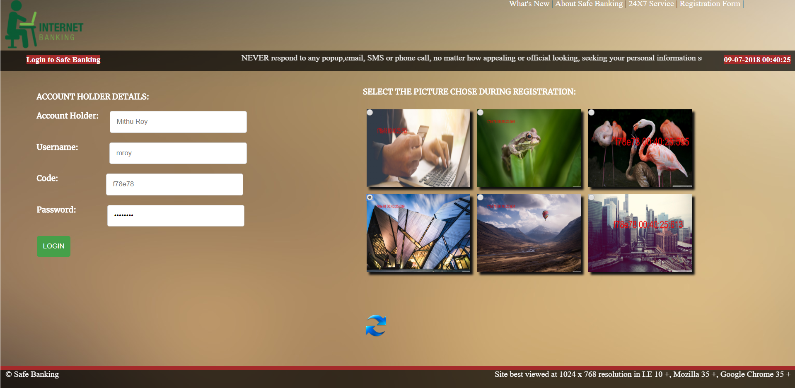
Login Validation
File name: login2.jsp
This page is responsible for fetching the account holder details from the account number provided in the previous page.
In order to move to the next page, we need to first click on the correct image which was give by the account holder at the time of registration.
Type in the the correct password and click on LOGIN

Slide 20
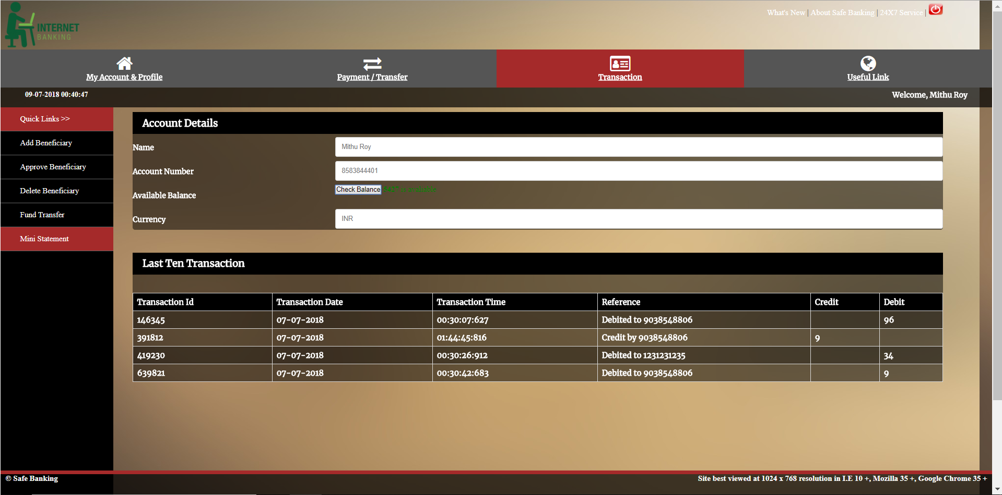
Login Successful
File name: fetch_transaction.jsp
On successful login authentication, control lands to account summary page.

Slide 21
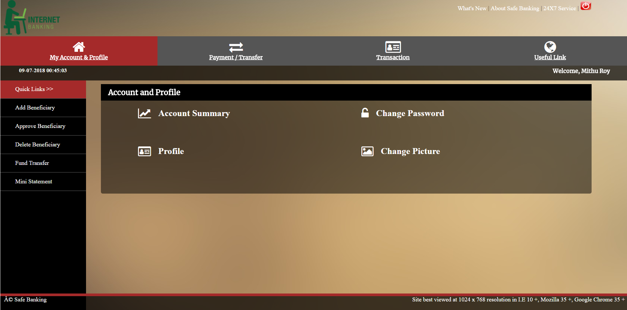
Menu
The functionality of the banking system can be divided into following categories:
My Account & Profile
Payment/Transfer
Transaction
Useful Link

Slide 22
1. My Account & Profile
This has the following sub catagories:
1.1 Account Summary
1.2 Change Password
1.3 Profile
1.4 Change Picture

Slide 23
1.1. Account Summary
File name: fetch_transaction.jsp
This page is responsible for displaying all the bank account related information like Account Details, Last Ten Transactions.

Slide 24
1.2. Change Password
File name: change_password.jsp
This page is responsible for changing the password and updating it into the database.
For changing password, we provide two modes:
Generate One Time Password (OTP)
Visit Branch.

Slide 25
a) Generate One Time Password (OTP)
File name: change_password2.jsp
This page is responsible for changing the password via OTP.
The OTP is being sent to the user’s email address.
The OTP needs to be entered correctly into the box in order to redirect the page to change_password4.jsp where we can enter new password.
On successful actions, the new password is being stored into the database.
Stepwise password changing activity is shown below

Slide 26
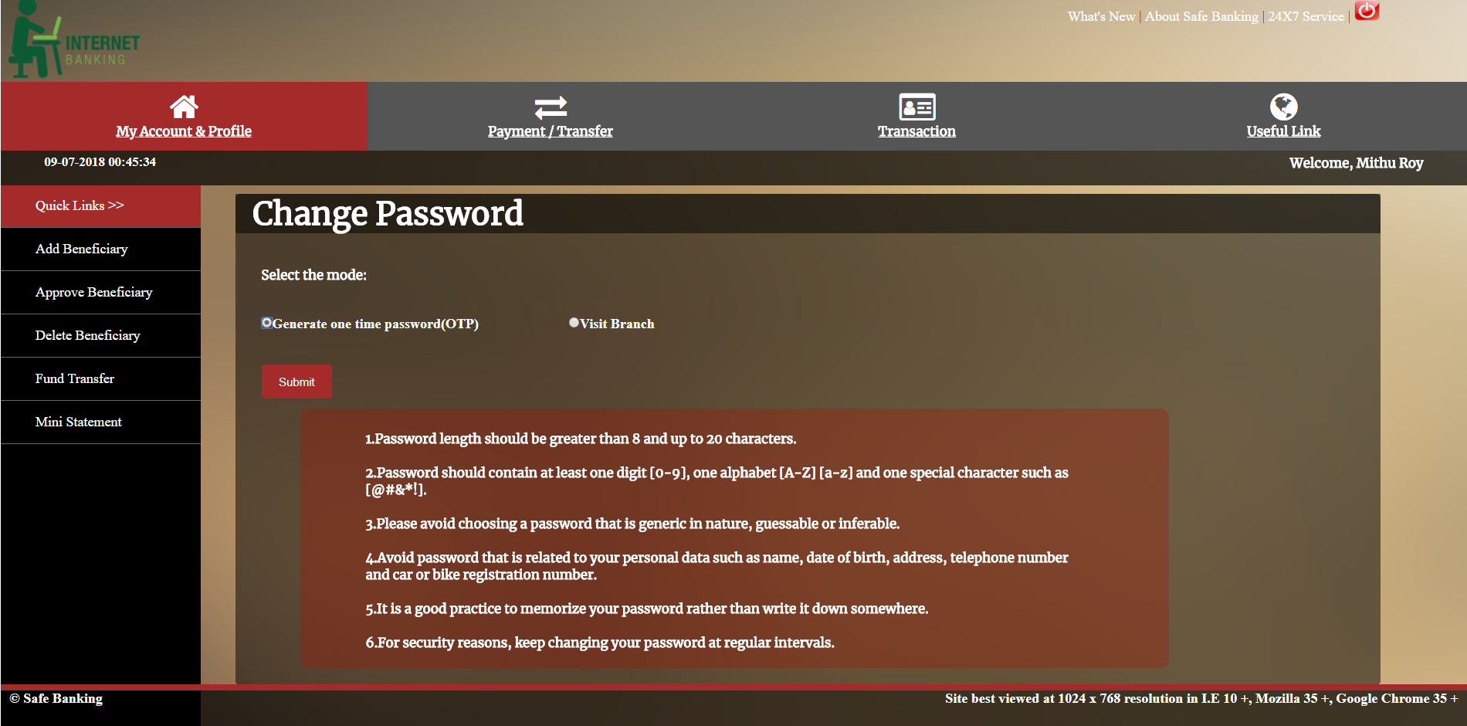
Step1:
File name: change_password.jsp

Slide 27
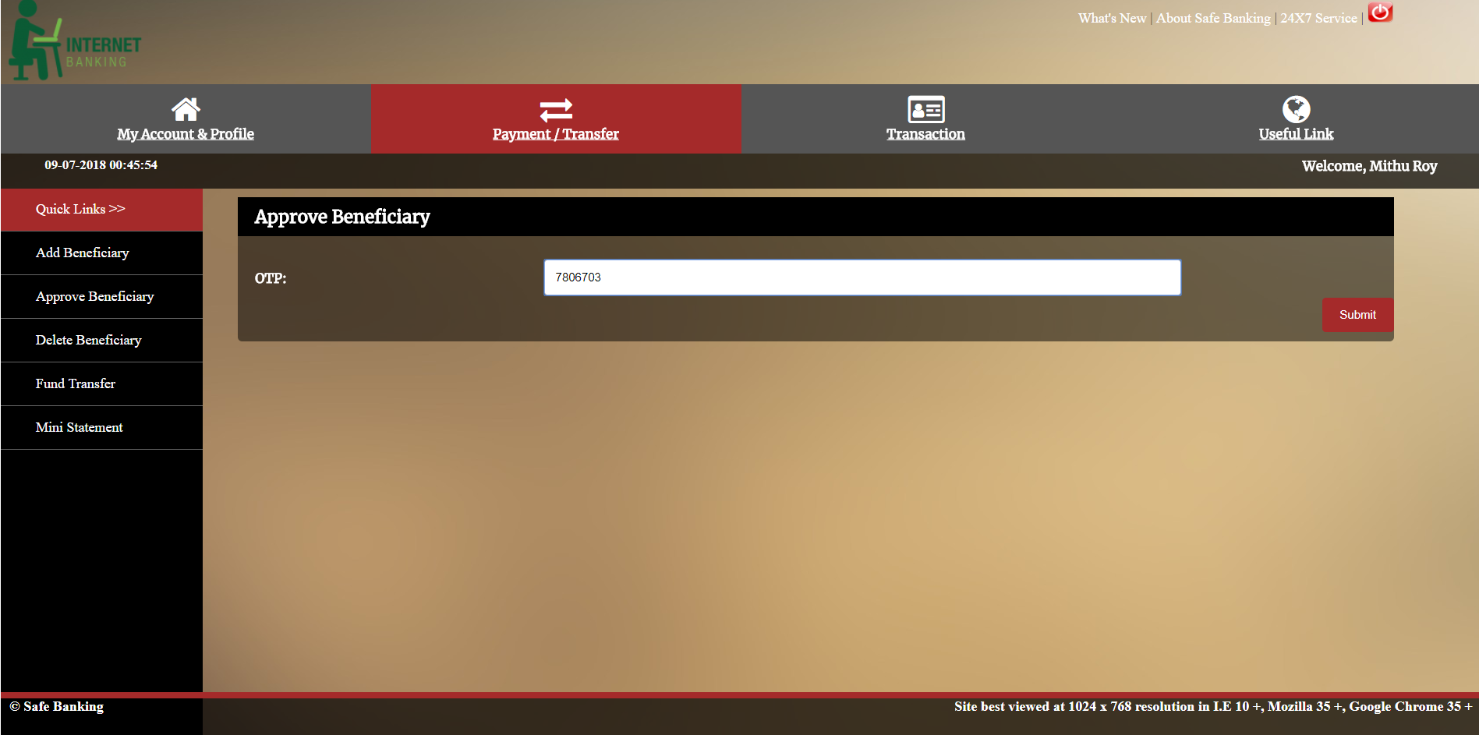
Step2:
File name: change_password2.jsp

Slide 28
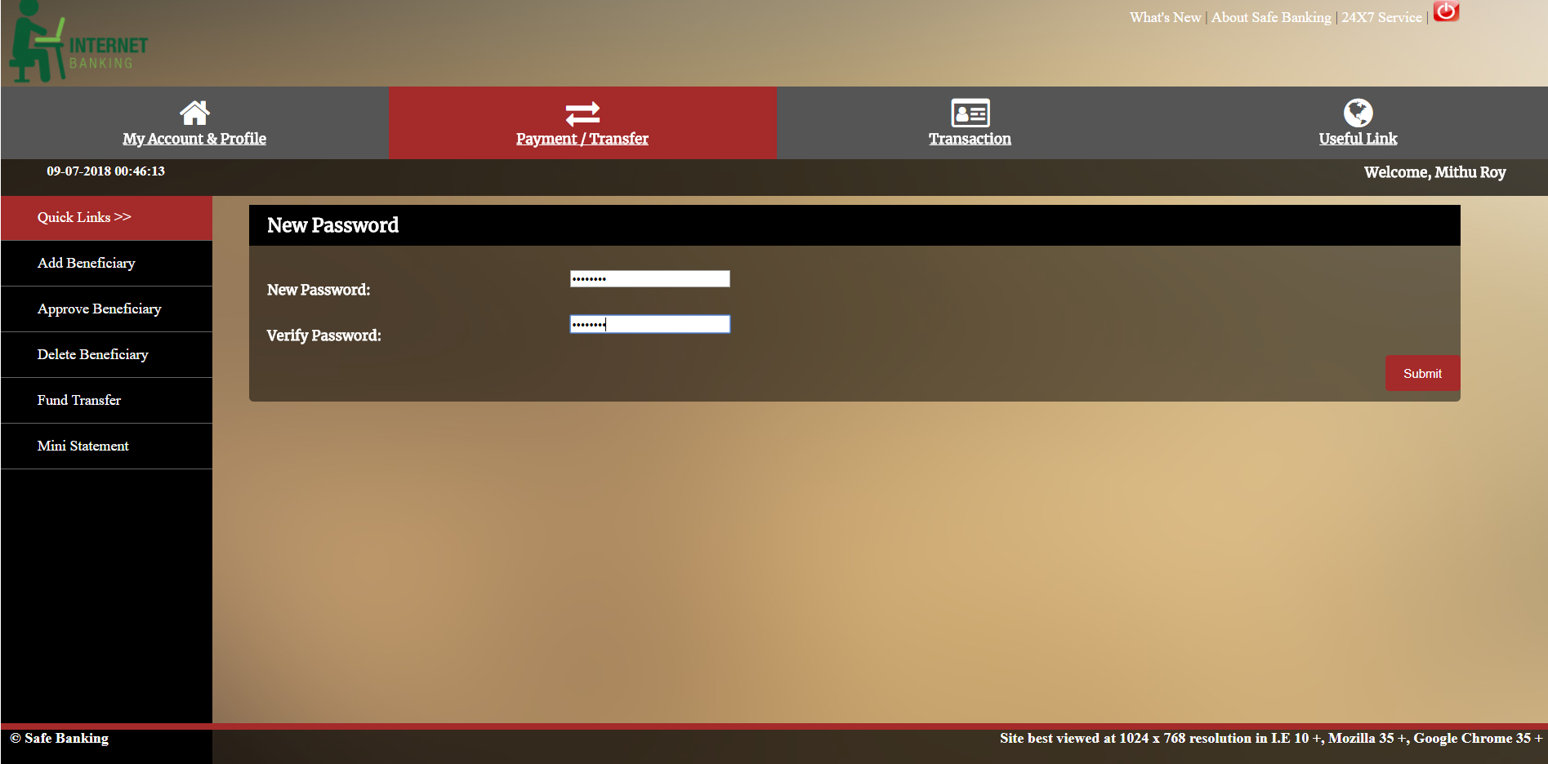
Step3:
File name: change_password3.jsp

Slide 29
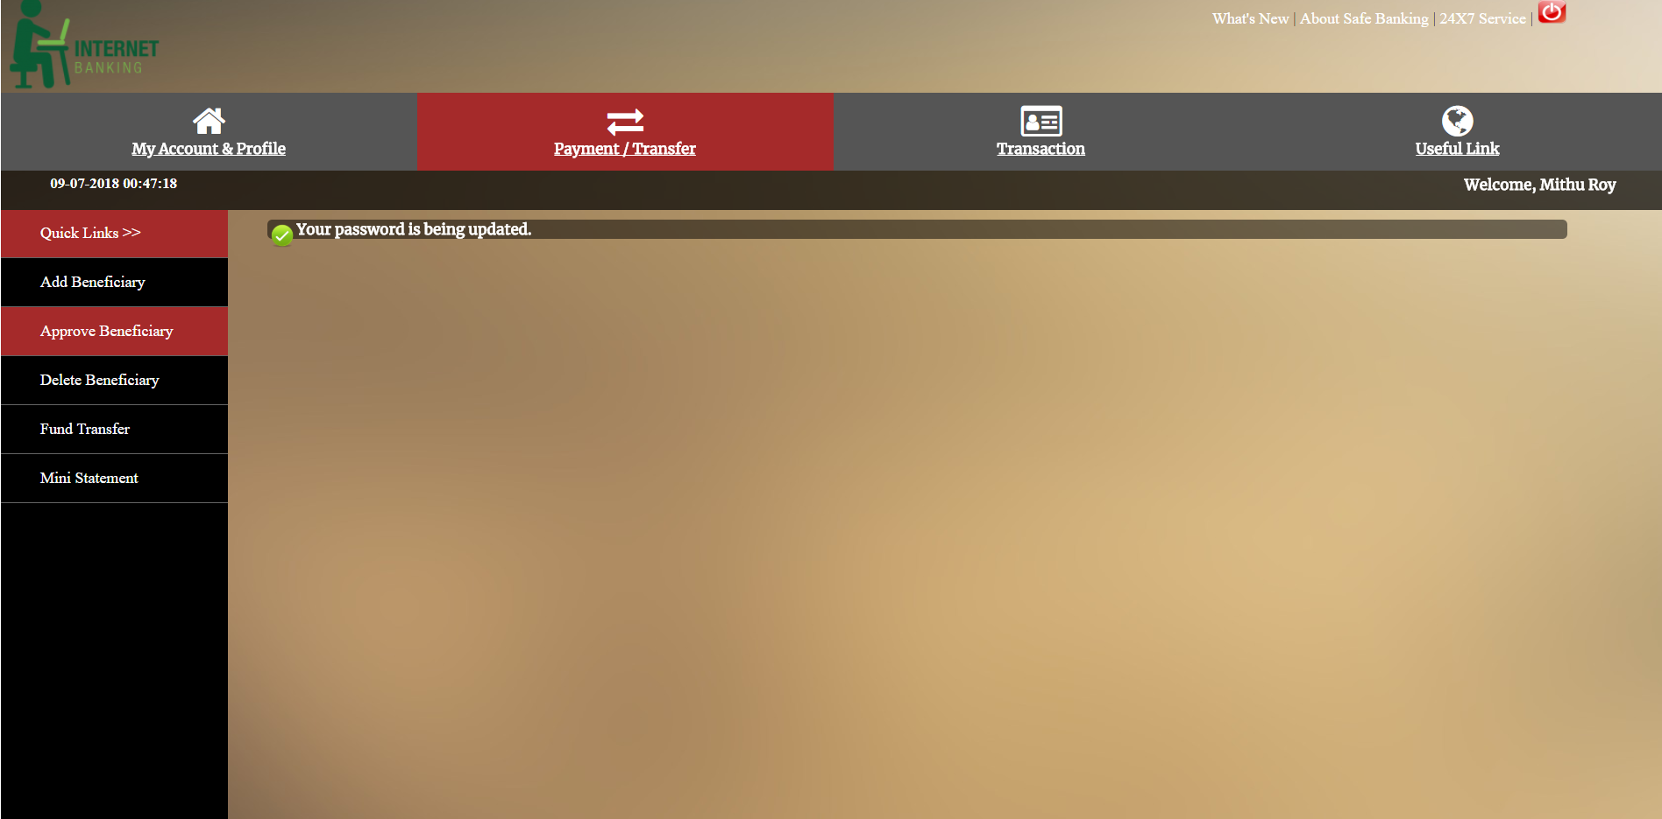
Step4:
File name: success_password.jsp

Slide 30
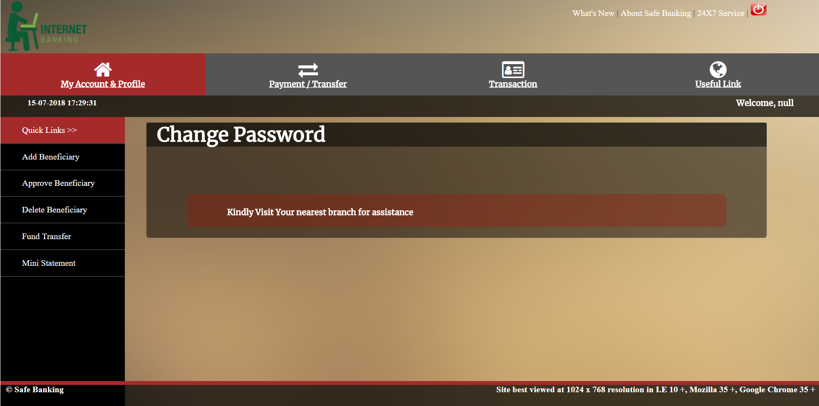
b) Visit Branch
File name: change_password4.jsp
This page is responsible for displaying the steps that should be followed to change password from the bank.

Slide 31
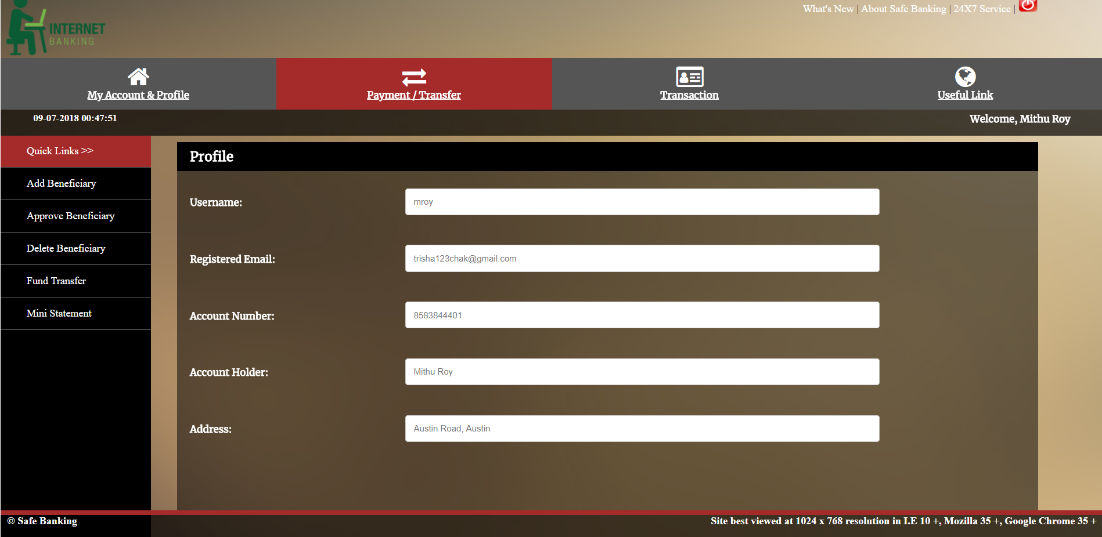
1.3. Profile
File name: profile.jsp
This page is responsible for displaying all the user’s information registered with the bank.

Slide 32
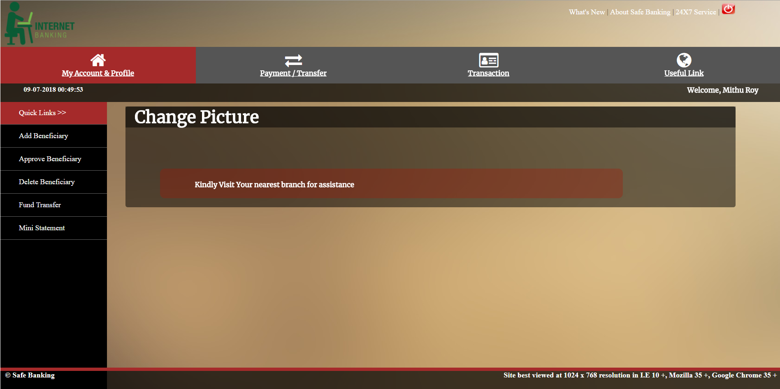
1.4. Change Picture
File name: change_picture.jsp
This page is responsible for displaying the the steps which should be followed if in case user wants to change the security picture.

Slide 33
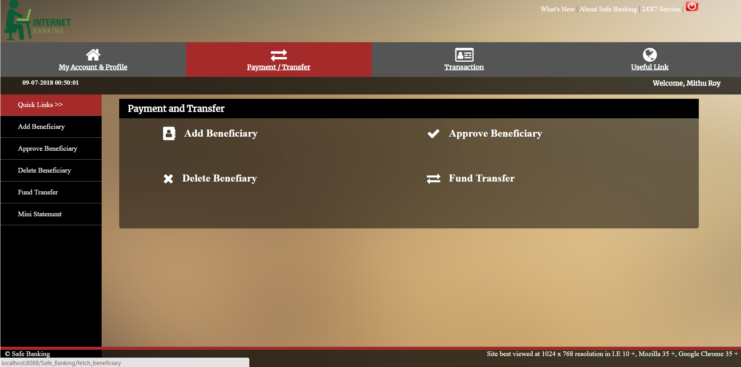
2. Payment/Transfer
This has the following sub catagories:
2.1 Add Beneficiary
2.2 Approve Beneficiary
2.3 Fund Transfer
2.4 Delete Beneficiary

Slide 34
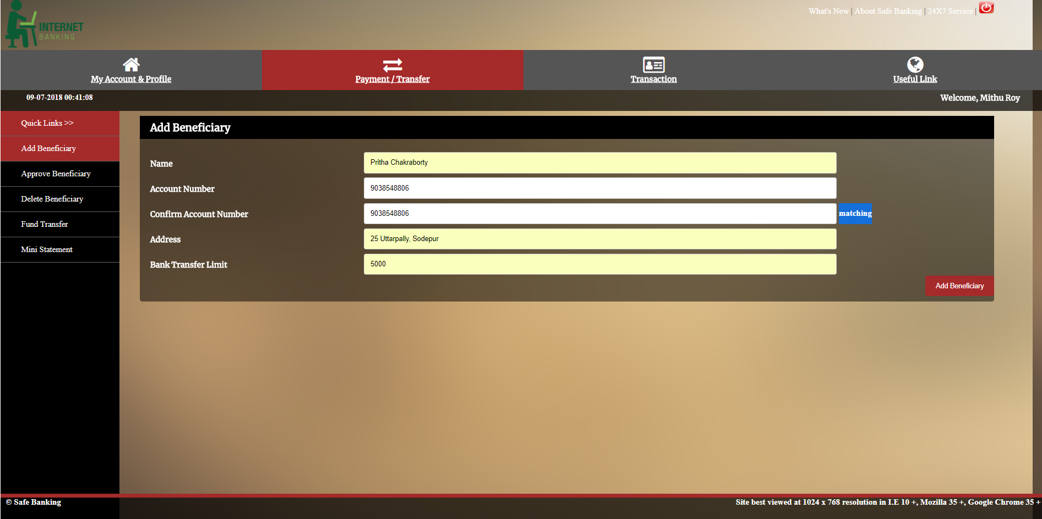
2.1. Add Beneficiary
File name: add_beneficiary.jsp
Type in the mandatory fields like Account number, confirm account number and bank transfer limit.
This page is responsible for adding beneficiary name which could be added in order to transfer funds after approving the added beneficiary.

Slide 35
2.2. Approve Beneficiary
File name: approve_beneficiary.jsp
This page first displays the list of beneficiary names that needs to be approved.
On submitting ‘Approve Beneficiary’ on the desired beneficiary name, the control will land to approve_beneficiary_form.jsp, where we need to type in the OTP which is being sent to the user’s email id.
This page is responsible for approving the beneficiary for later availing fund transfer facility.

Slide 36
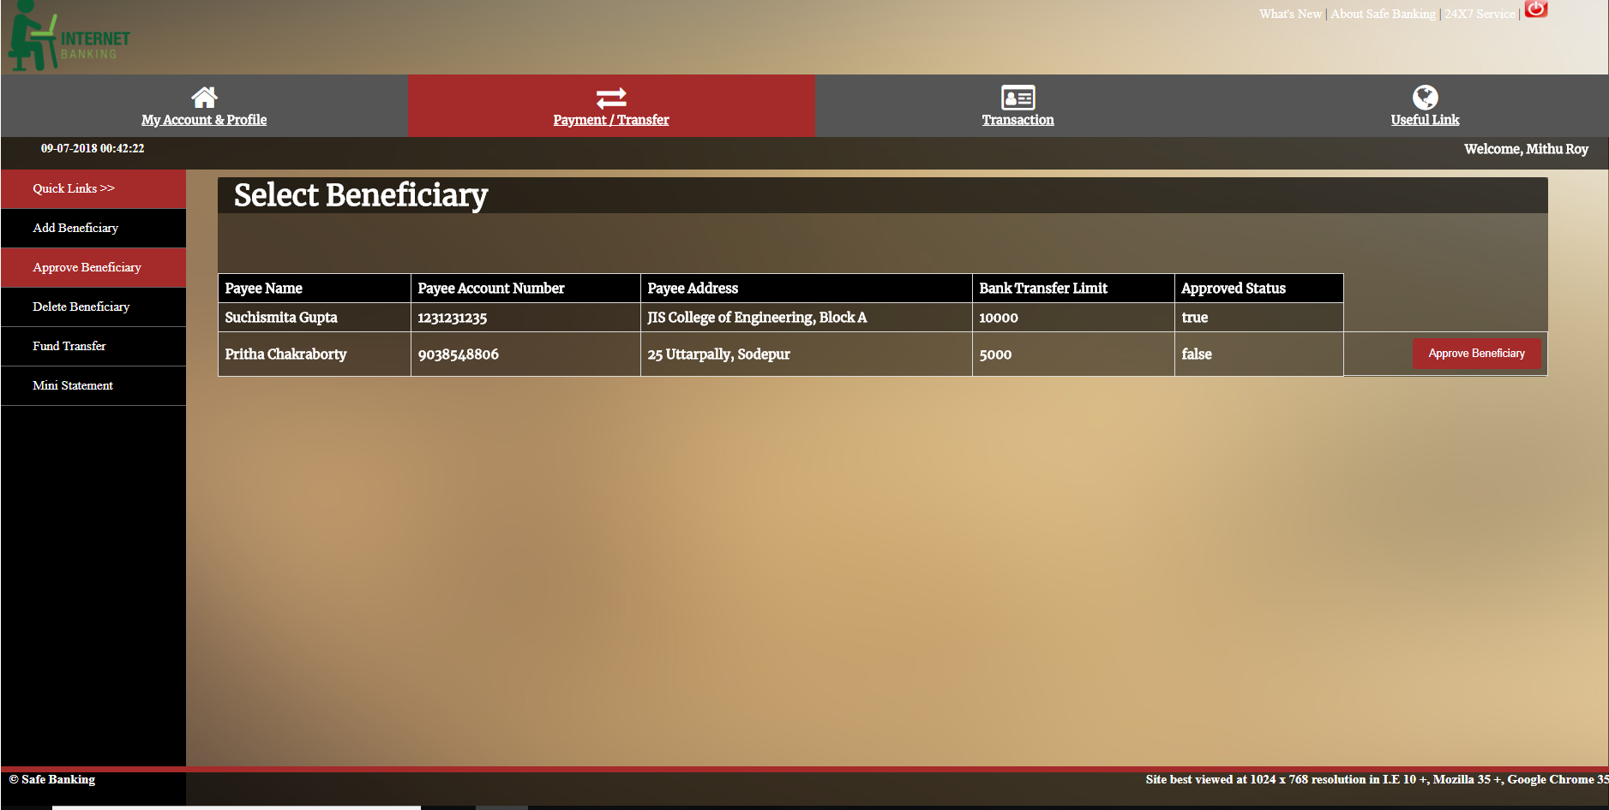
Step1:
File name: approve_beneficiary.jsp

Slide 37
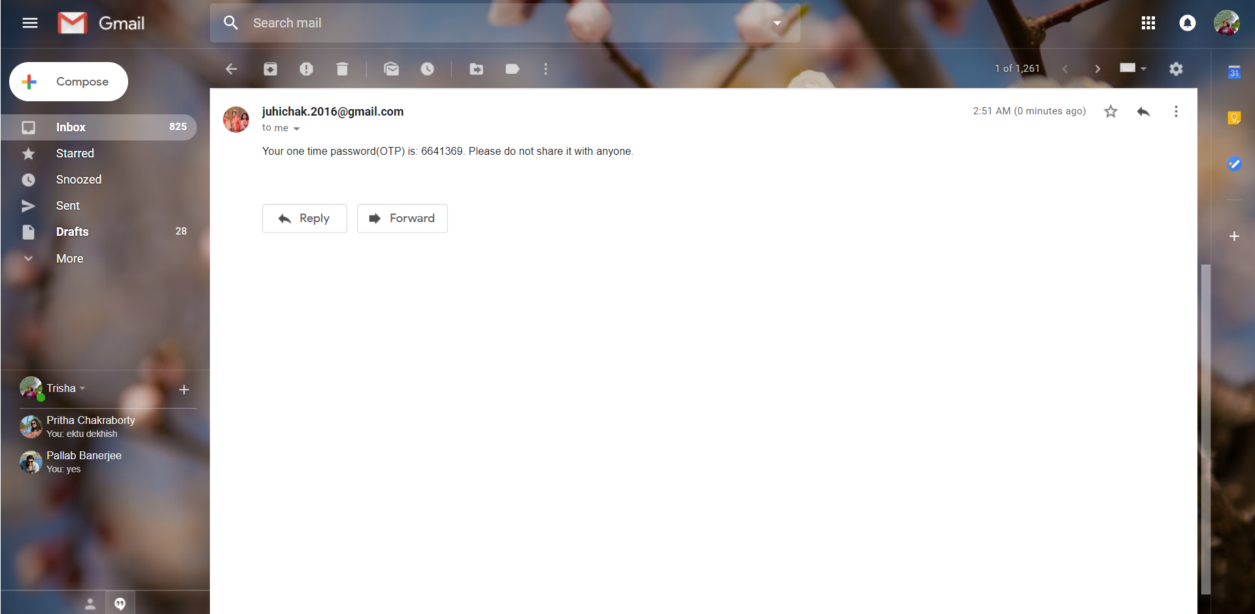
Step2:
Email sent to registered email ID

Slide 38
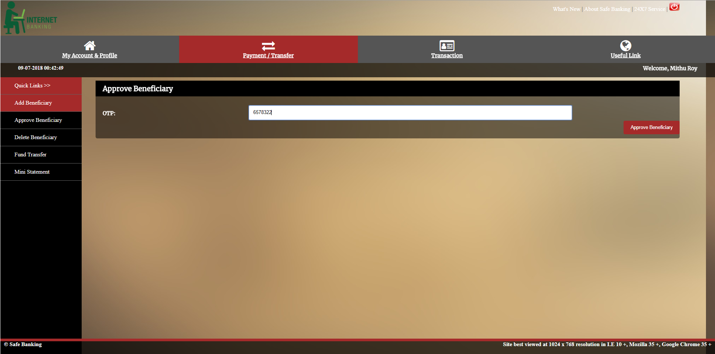
Step3:
File name: approve_beneficiary_form.jsp

Slide 39
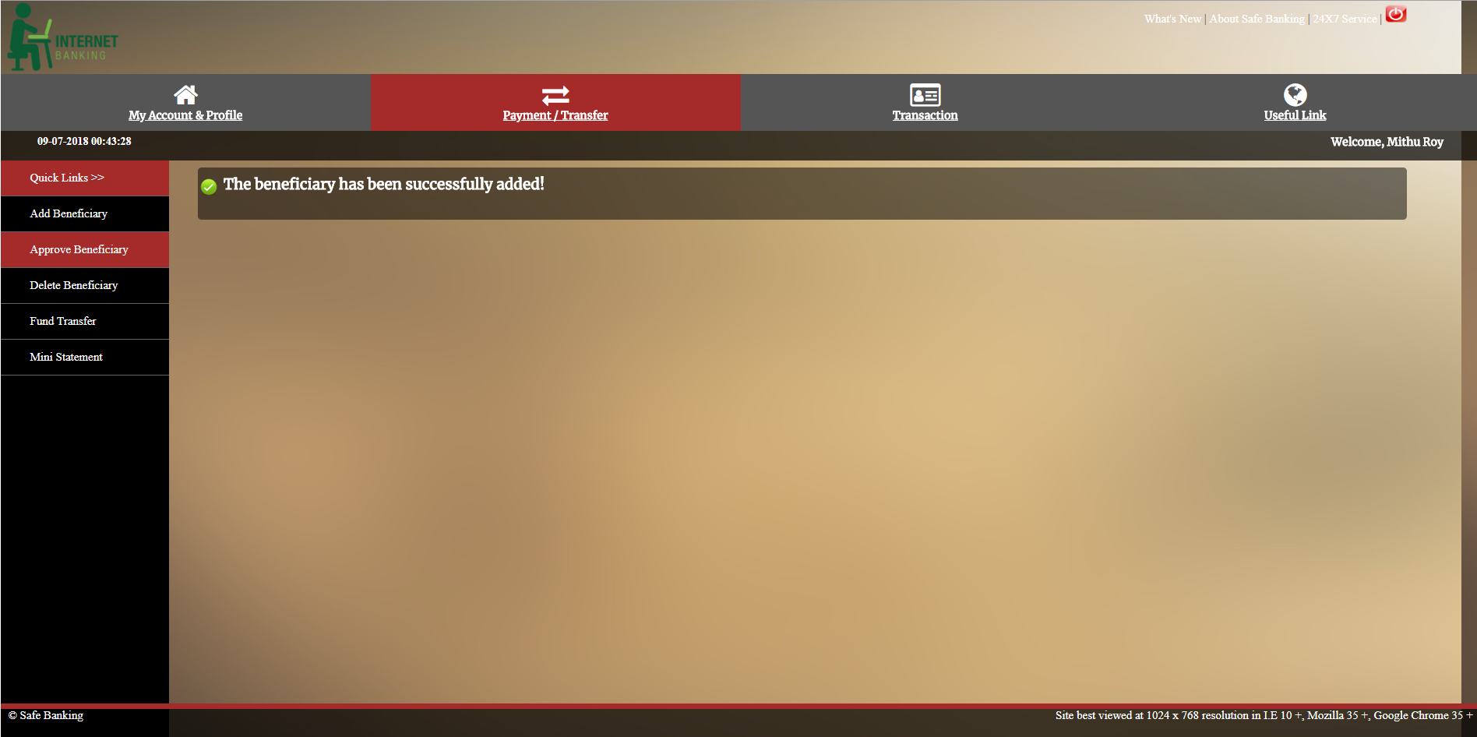
Step4:
File name: approved.jsp

Slide 40
2.3. Fund Transfer
File name: fetch_beneficiary.jsp
This page first displays the list of beneficiary names that has been approved.
Select the desired beneficiary name, and hit on ‘Fund Transfer’ button.
The control will land to fund_transfer_form.jsp, where we need to type in the amount that needed to be transfered.

Slide 41
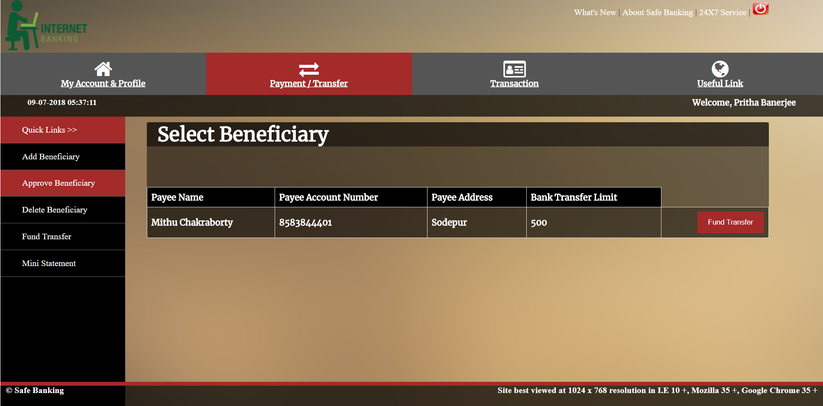
Step1:
File name: fund_transfer.jsp

Slide 42
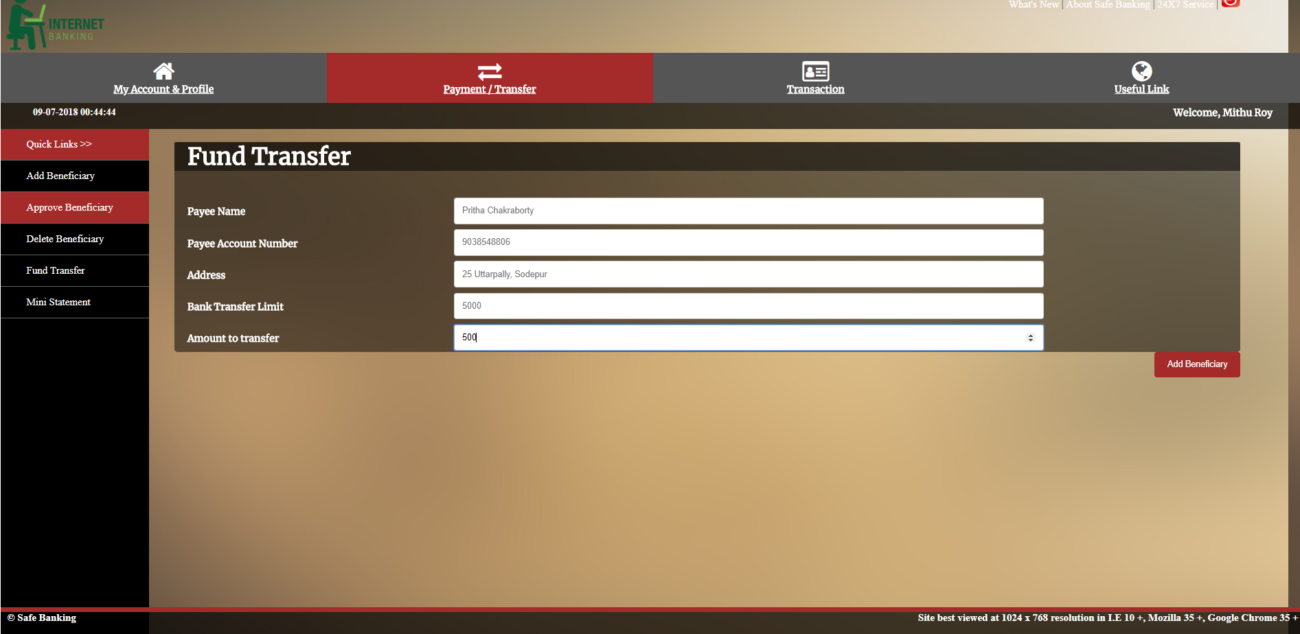
Step2:
File name: fund_transfer_form.jsp

Slide 43
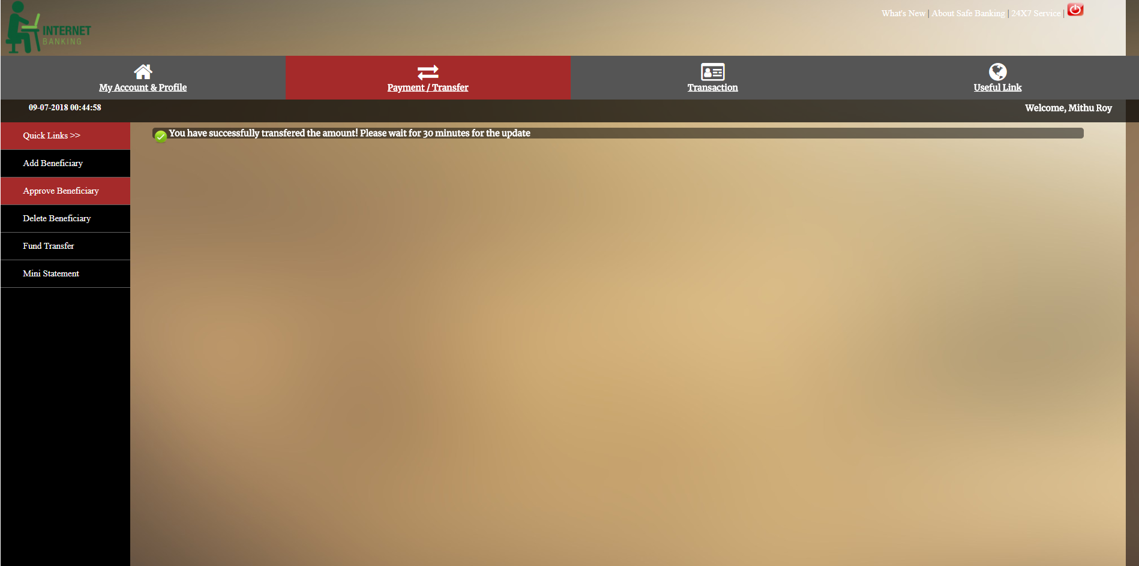
Step3:
File name: success.jsp

Slide 44
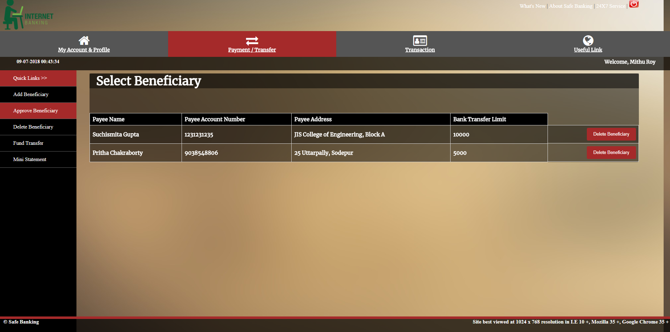
2.4. Delete Beneficiary
File name: delete_beneficiary.jsp
This page first displays the list of beneficiary names that has been approved.
Select the desired beneficiary name, and hit on ‘Delete Beneficiary’ button.

Slide 45
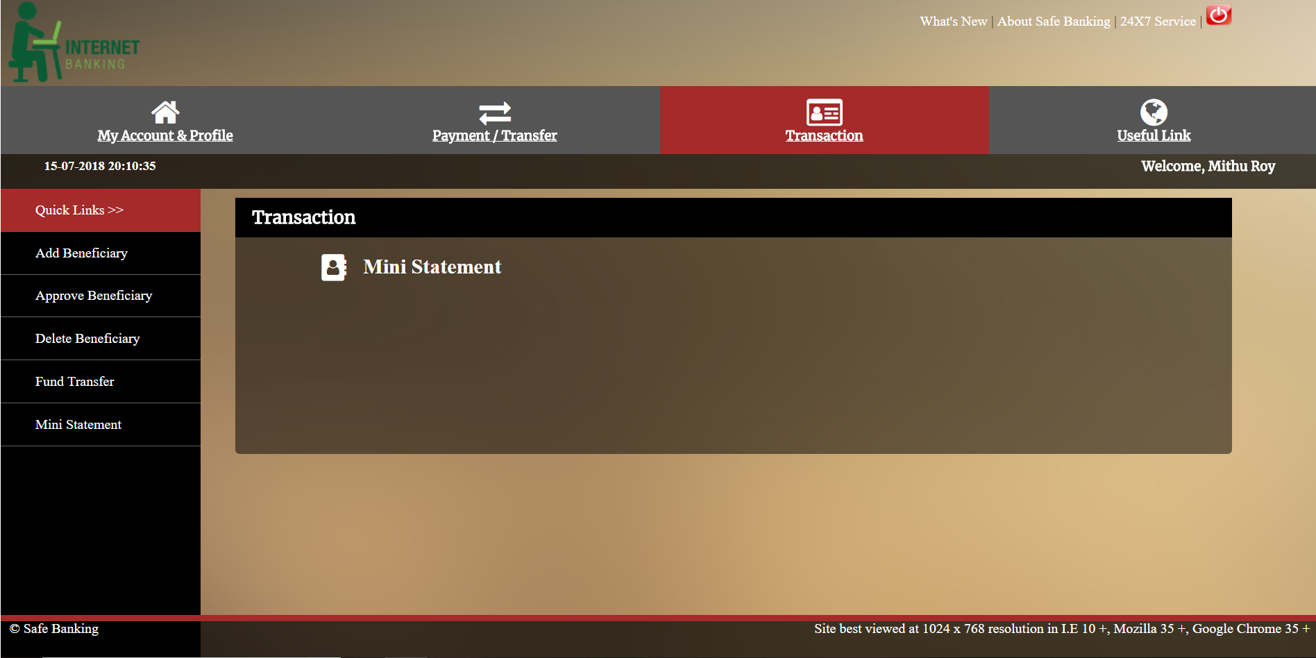
3. Transaction
This has the following sub catagories:
3.1 Mini Statement

Slide 46
3.1. Mini Statement
File name: fetch_transaction.jsp
This page is responsible for displaying all the bank account related information like Account Details, Last Ten Transactions.

Slide 47
Login-Logout Log

Slide 48
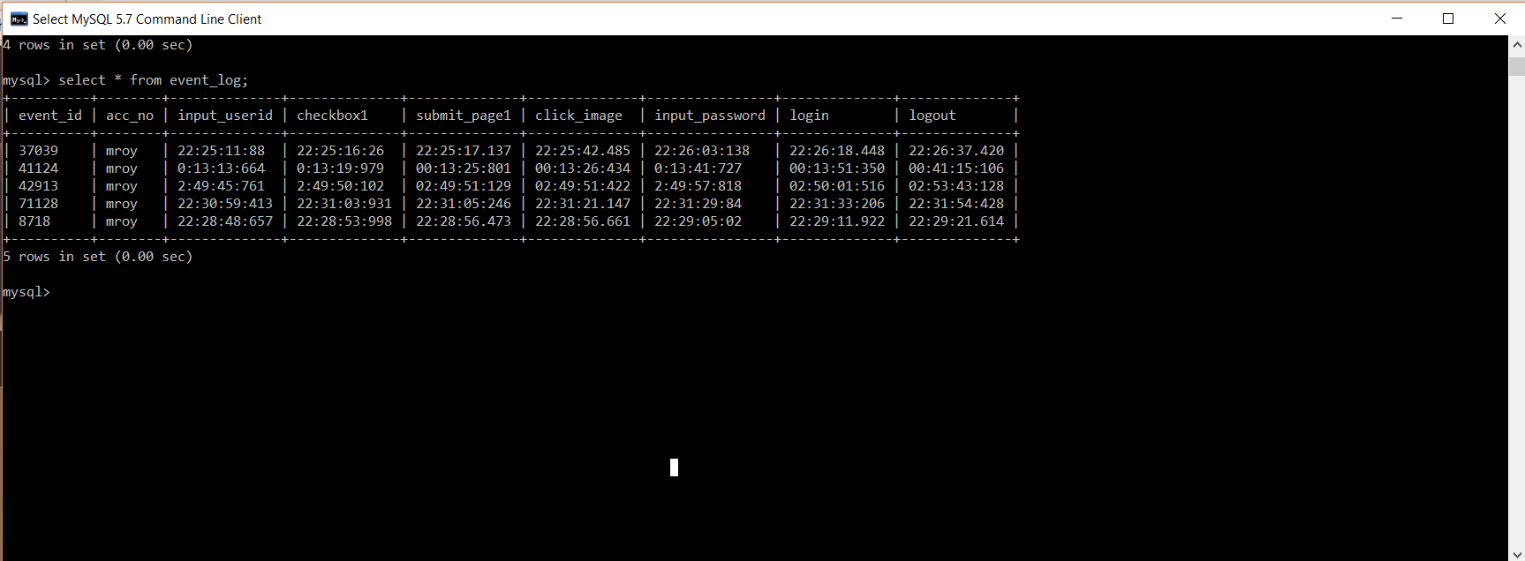
Log table
Database table name: event_log
To view the log table:
Open mySQL command line.
Provide password: trisha97
Change directory→ use iitr;
Type Query: select * from event_log;

Slide 49
Admin Login Slides

Slide 50
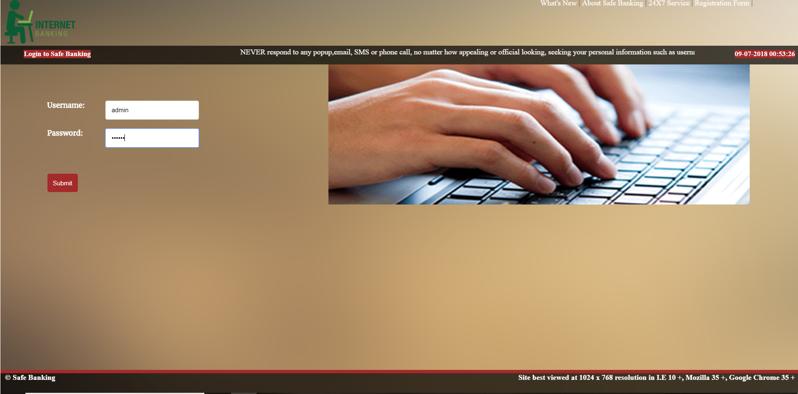
Login
File name: admin_login.jsp
This page is responsible for opening admin profile after validation.
Userid→ admin
Password→trisha

Slide 51
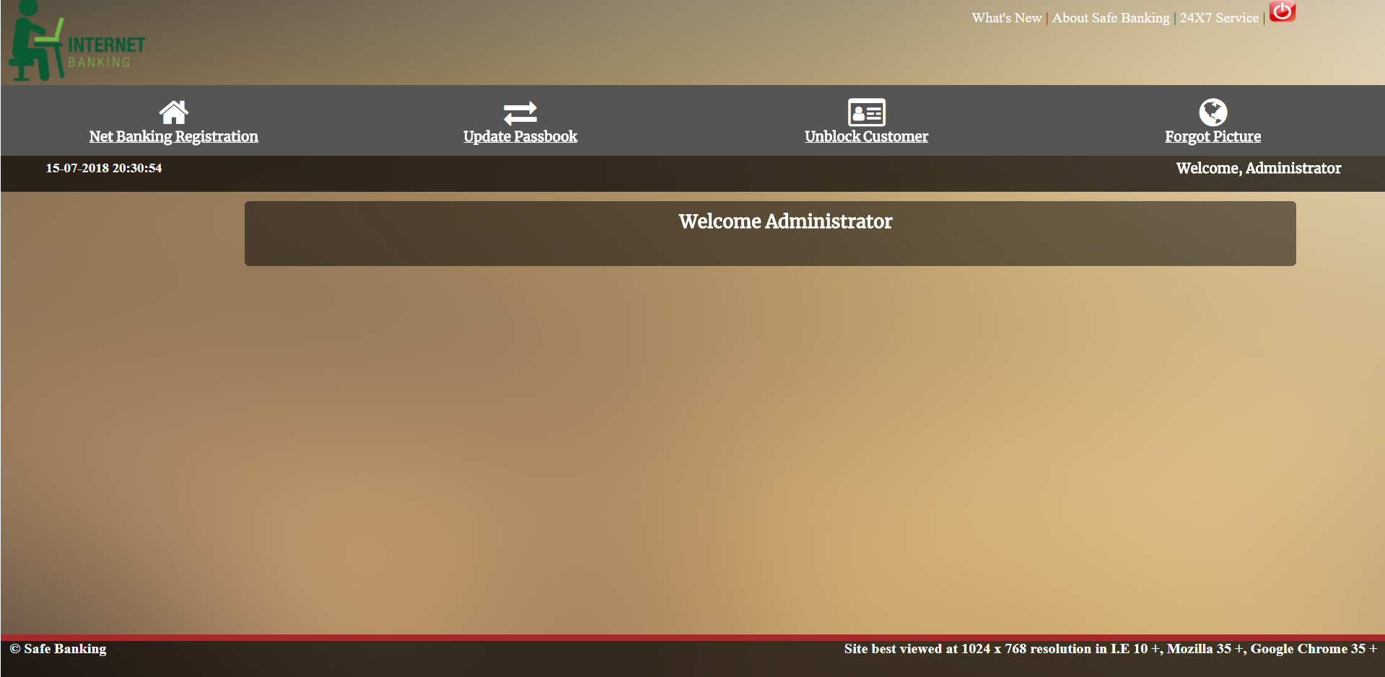
Menu
The functionality of the admin can be divided into following categories:
The net banking registration
Update Passbook
Unblock Customer
Forget Picture

Slide 52
1. Net Banking Registration
File name: registration1.jsp
Any customer who wants to avail online netbanking facility must enrol themselves from the admin
The admin will first assign a account number and hit on Submit.
The customers would be asked to fill out the form consisting of customer’s personal details which would be stored with the bank. The user would choose a security picture to ensure an extra layer of security.
As soon as the user account has been created for online netbanking, the admin would explicitly add initial fund to each account by the following steps:
Open mySQL command line.
Provide password: trisha97
Change directory→ use iitr;
Type Query: insert into account values(‘8583844401’,6000,0,1000);
Minimum Amount
Account number
Current Account
Savings Account

Slide 53
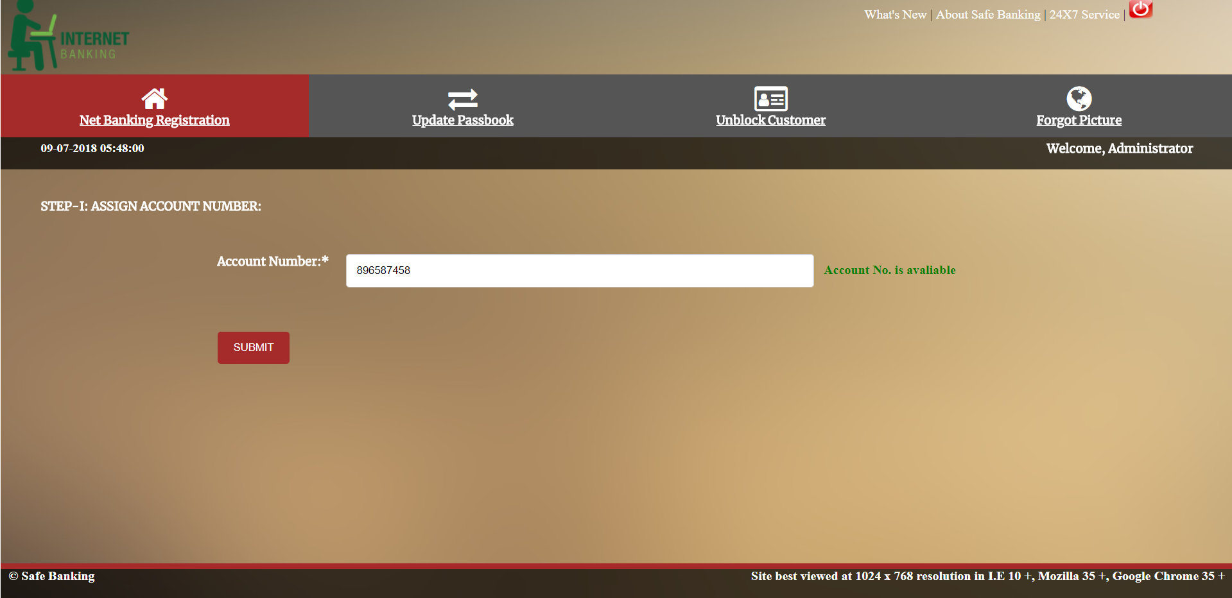
Step1:
File name: registration1.jsp

Slide 54
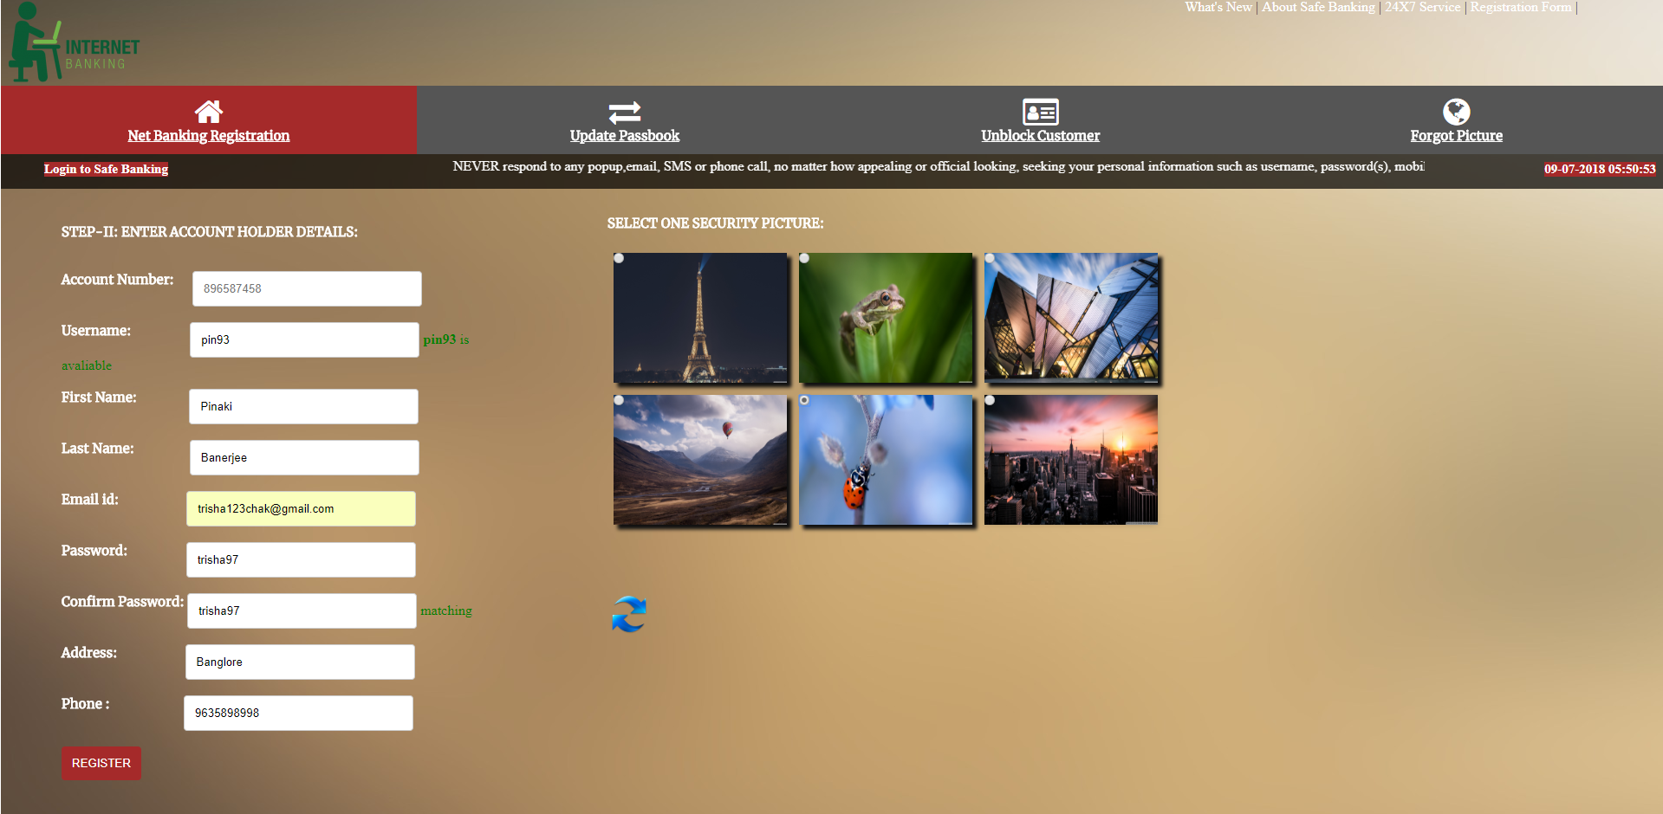
Step2:
File name:registration2.jsp

Slide 55
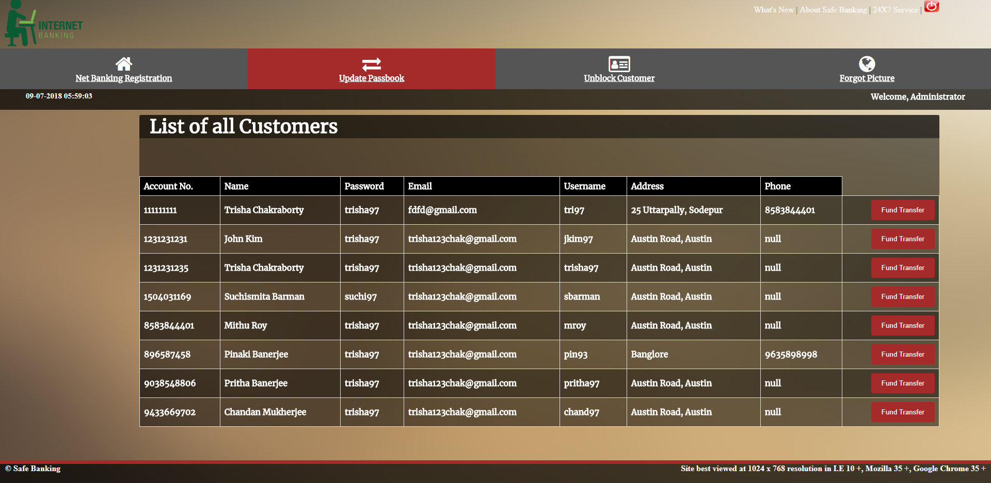
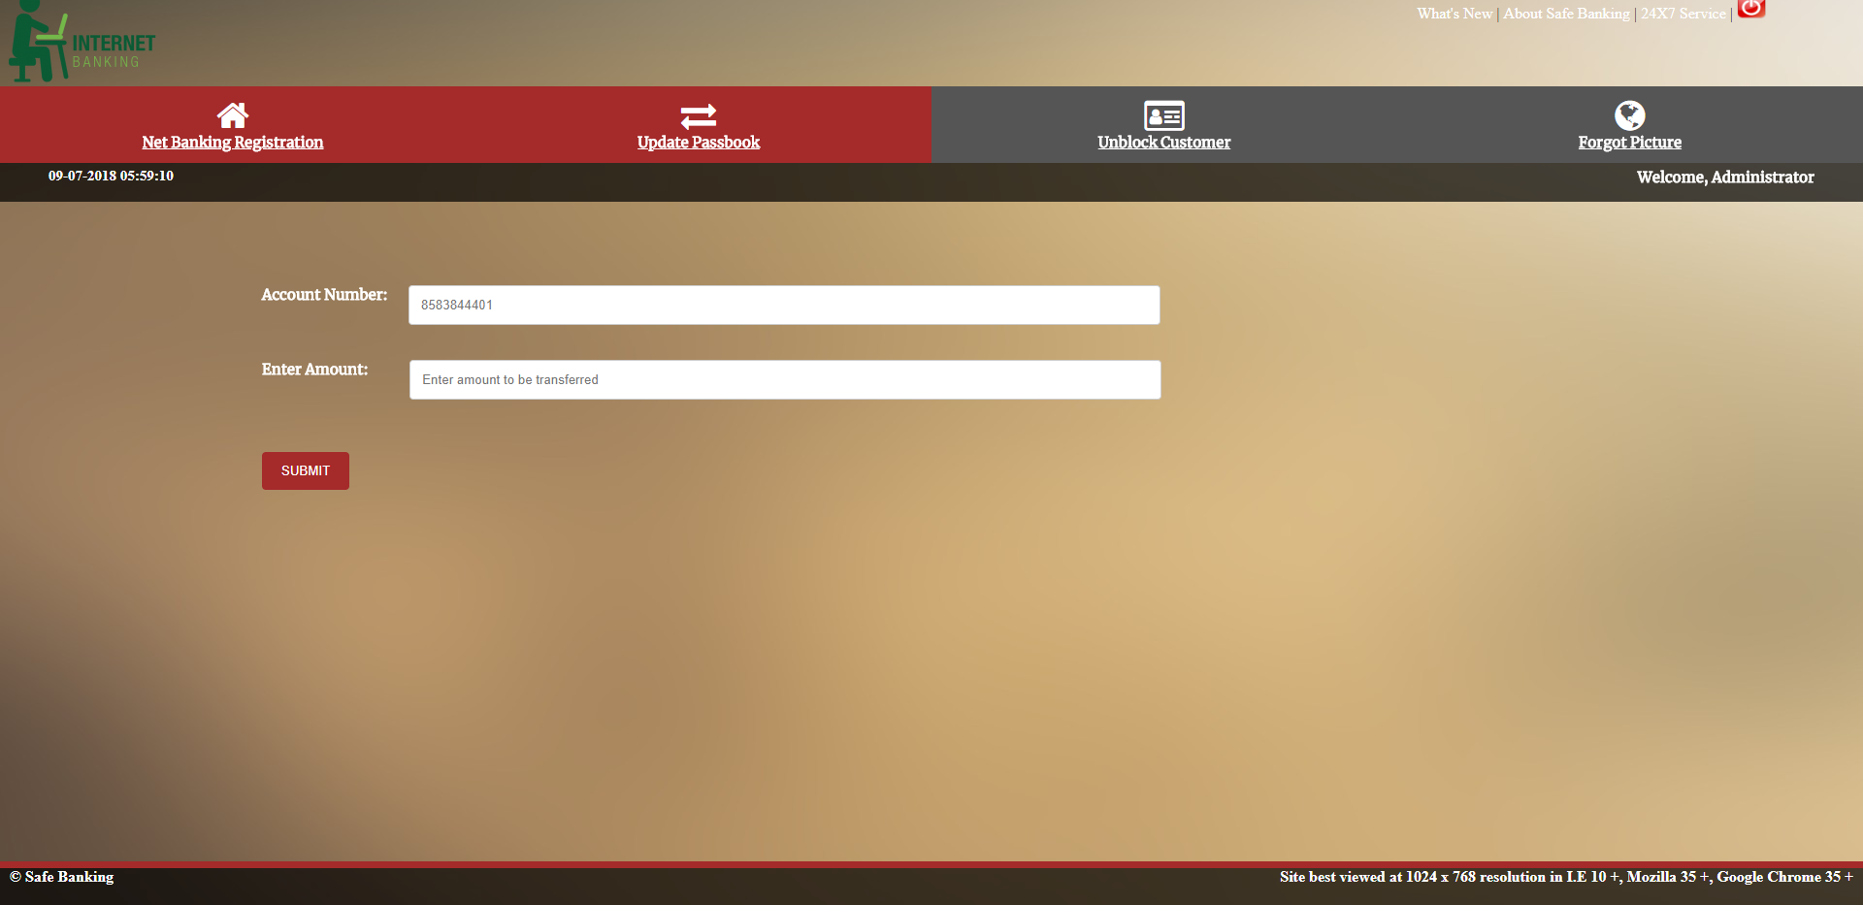
2. Update Passbook
File name: transfer_money.jsp
This page is responsible for updating money in user account after user deposits money offline into the bank.
This page will show list of customers of the bank.
Track down the customer who have deposited the amount offline and click on ‘Fund Transfer’
The control lands to transfer_money_form.jsp and type in amount to be transferred.

Slide 56
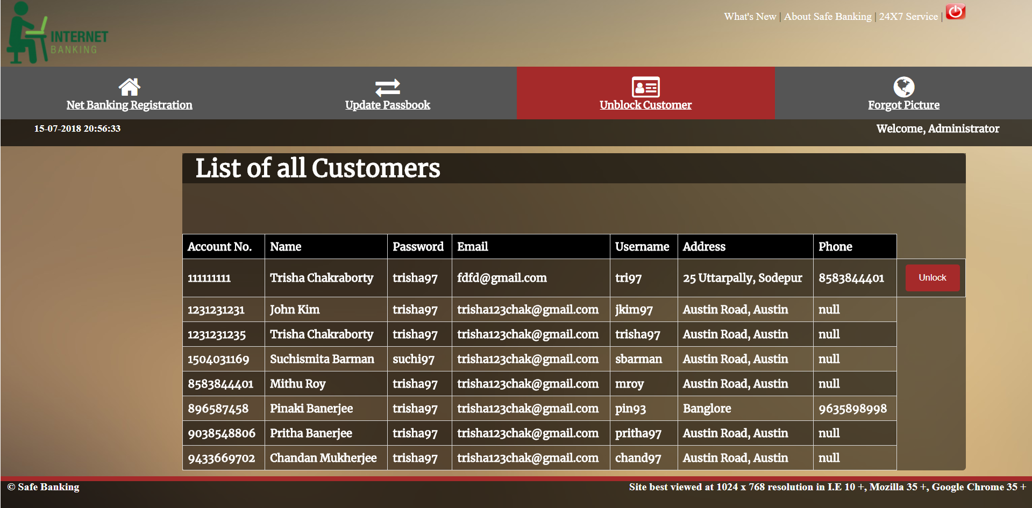
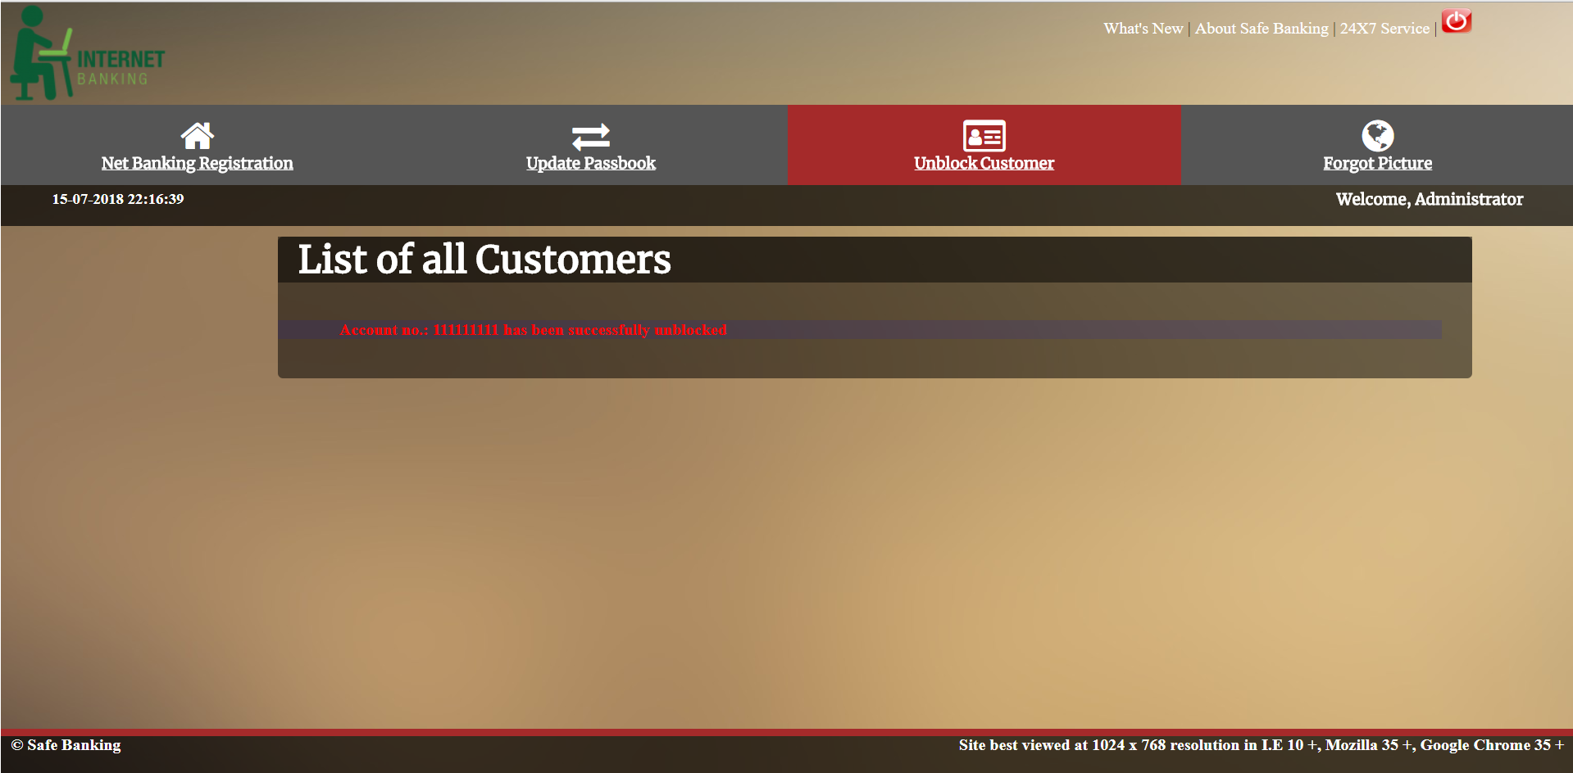
3. Unblock Customer
File name: unblock_customer_list.jsp
This page is responsible for unblocking the users those who have entered wrong credentials for 5 times.
This page will show list of customers of the bank.
Track down the customer who have been blocked.

Slide 57
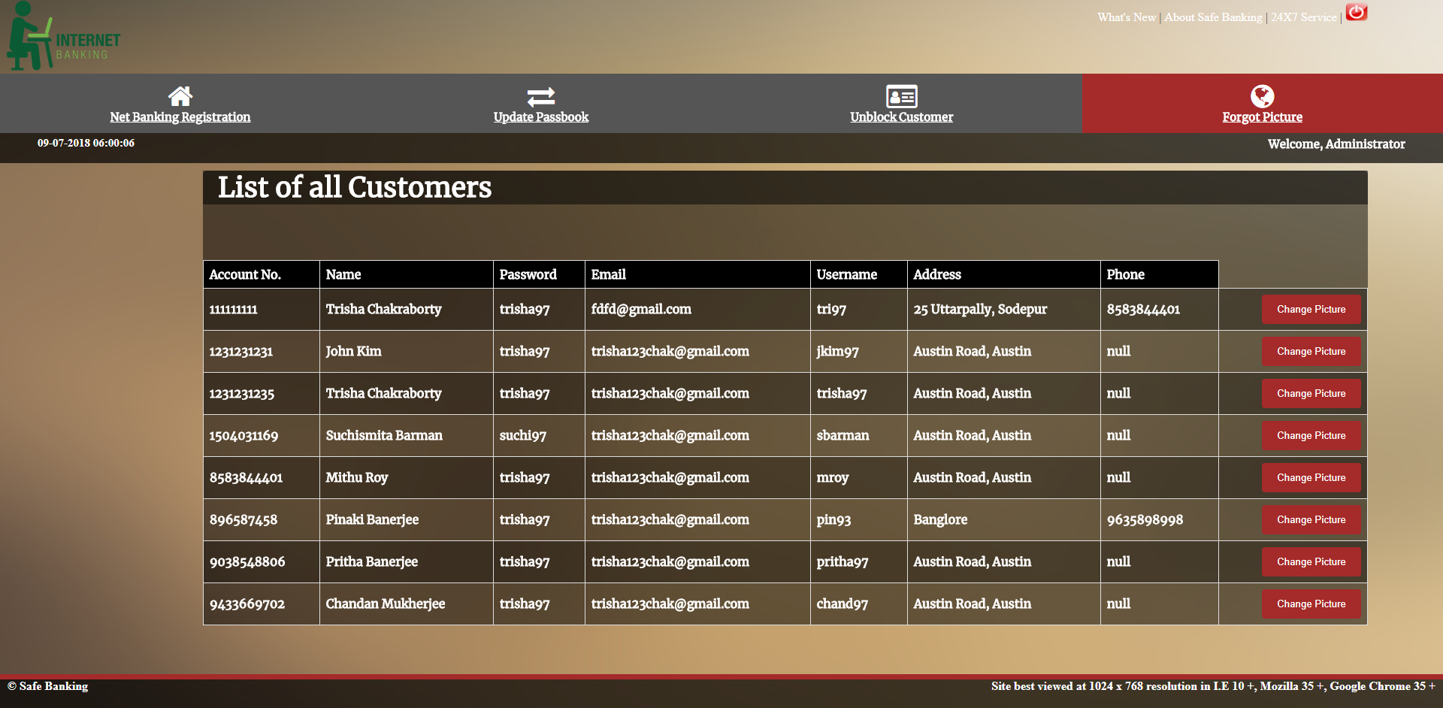
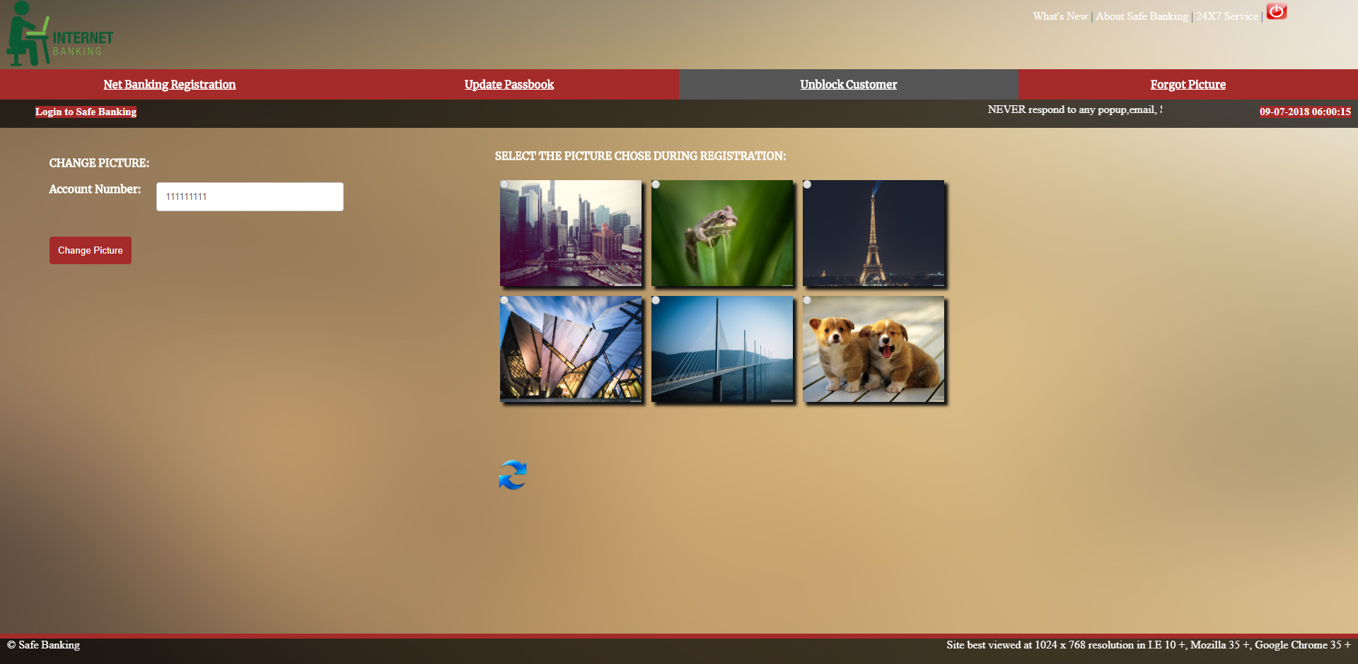
4. Forgot Picture
File name: forgot_picture.jsp
This page is responsible for recovering the customers who have forgotten the security picture associated with the account.
This page will show list of customers of the bank.
Track down the customer who wants to change the picture.
The control lands to forgot_picture2.jsp and select a new security picture.

Slide 58
Future Scope

Slide 59
Android App
In the future, we can make an android app of this website for better mobility and accessibility. Android apps add an uniform and interactive interface to the web interface.

Slide 60
Thanks!

